Slide 1
The power of early years
Milica Pejović Milovančević

Slide 2
Early childhood development
Early childhood development is the period between 0 and 8 years of age and represents a process of maturation and interaction that leads to the progression of perceptual, motor, cognitive, language, social-emotional and self-regulation skills.

Slide 3
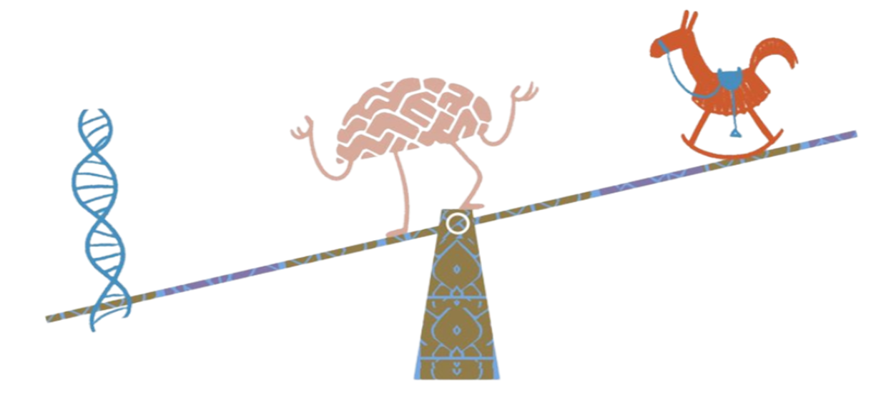
Brains are shaped by genes and experiences
Notes:
The debate over which factor has a greater influence on brain development — genes or environment — is over.
We used to say it was nature OR nurture; then nature and care.
We now know that it is nature together with nurture, whose degree of interdependence is greater than we could ever imagine.
They are two parts of one whole, constantly influencing each other, and together they play a unique role in the development of the child's brain — and in the child's future.
Genes provide the blueprint for brain development, but it is the environment that shapes it.

Slide 4
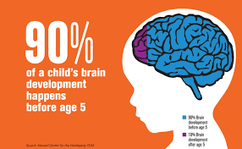
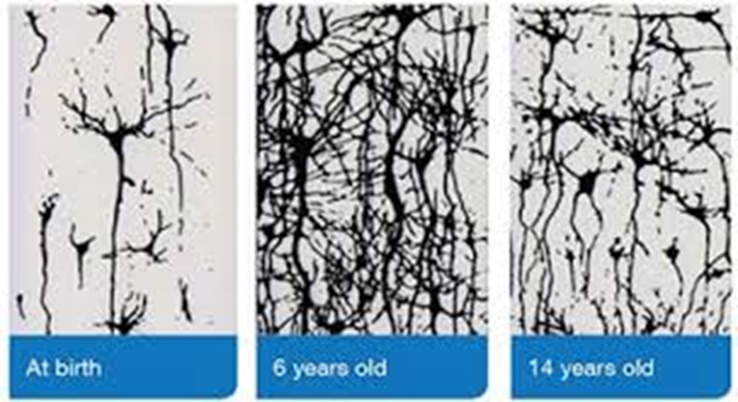
Development in early years
Notes:
Brain cells communicate via electronic signals thus creating circuits
Whether a circuit will be significant depends on environmental factors and experience
If the circuit is used, it remains throughout life, if not, it disappears
Similar to building a house –there is no good building without a solid foundation and good connections– the same applies to the brain!

Slide 5
The architecture of the baby's brain
The brain develops even after the birth of the child
Simple connections are established in the earliest age, while increasingly complex ones arise during the process of development
Genes provide the basis of what our brain should look like, but life experiences influence how our brain will actually function
Notes:
Plasticity, that is, the ability of the brain to reorganize and adapt, is most pronounced in the first years of life and declines with age

Slide 6
Significance
The brain develops the most
Capacities for progress
The most pronounced plasticity of the brain
Sensitivity to external influences
A unique opportunity to:
Form a stimulating environment
Eliminate risk factors
Engage in early interventions

Slide 7
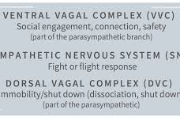
THE BRAIN IS A CULTURAL ORGAN - EXPERIENCE SHAPES THE BRAIN
Notes:
Ventral vagal complex (VVC)
The system for social interaction depends on neurons - the VVC leads the way - we smile when others smile at us, nod when we agree and frown when we listen to what upsets us
When the VVC is engaged, it sends signals down into our body - heart, lungs - it calms and relaxes us
VVC explains how parents naturally help children to regulate themselves - babies in the early stages of life are pretty much at the mercy of us in the environment
When we smile at them, coo with their tongue, and chatter, we stimulate the development of their VVC and thereby help bring our babies' emotional arousal systems into harmony with their environment.
The VVC controls sucking, swallowing, facial expressions and sounds - and when it is stimulated babies are happy and content, feeling secure, which creates the basis for future social behaviors

Slide 8
MIRROR NEURONS
Notes:
The ability to feel what is in another - the basis of empathy
In 1994, through a random experiment with monkeys, the Italians discovered that brain zones are activated just by observing a certain action - the brain in the experiment reacted as an observer, "second-hand". Mirror neurons explain empathy, imitation, synchrony, even language development
Mirror neurons as neurological WiFi - we not only "buy" a person's movement, but also their emotional state and intentions
Our mirror neurons also make us vulnerable to other people's negativityContagious emotions!

Slide 9
Serve and Return
"Serve and Return" interaction between children and significant adults in their lives (similar to a tennis match interaction)
This process is fundamental to building the brain, especially in the earliest years.
Photo credits: Dusko Miljanic, UNICEF Montenegro

Slide 10
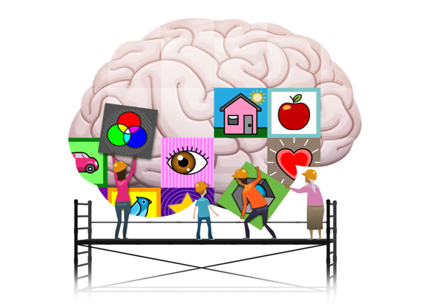
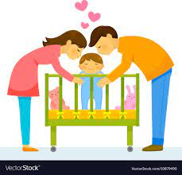
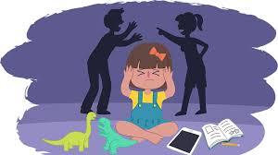
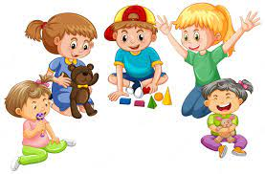
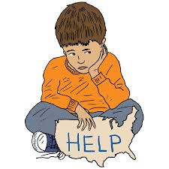
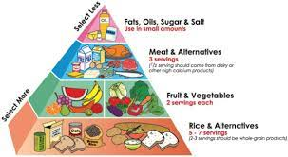
Future potential is influenced by early experiences
Notes:
Positive experiences –loving parents, play, safe and secure places, enough food
Negative experiences –violence, poverty hunger

Slide 11
Nurturing relationships
Notes:
Babies differ from birth in the intensity and nature of reactions to similar events - temperament
Whatever happens to the baby contributes to the emotional and perceptual map of the world created by its developing brain
The brain is formed in a use-dependent manner
Neurons that fire together, wire together
When neural networks fire again and again it can become a default setting - the response that is most likely to occur
If you feel safe and loved, your brain becomes specialized for exploration, play and cooperation

Slide 12
Positive early childhood experiences = the basis of healthy brain development in children.

Slide 13
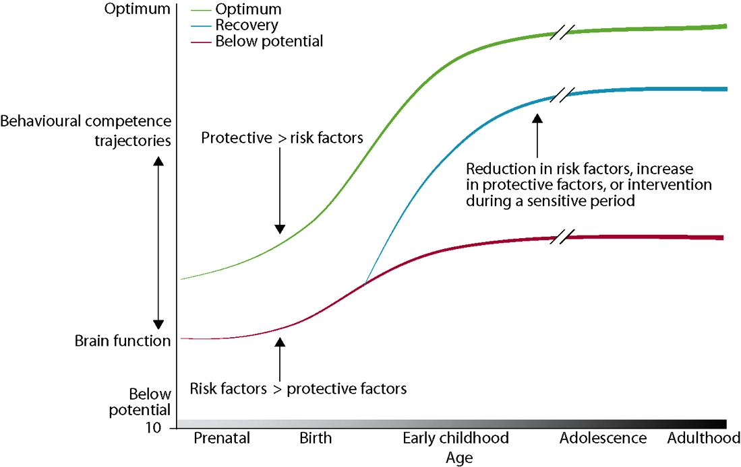
Developmental inequalities

Slide 14
The way young children learn
Learning takes place:
Through repetition of meaningful activities, multiple times, many times...
By giving children opportunities to participate in everyday activities that mean life - children are industrious, we tend to underestimate them thinking that they are too young to be engaged in some activities
The most important thing is to arouse children's interest in the activity – that is when they learn the best
Parents and caregivers are the best role models for their children
https://www.youtube.com/watch?v=6mXUa9qkCFg

Slide 15
The way children with disabilities learn
They learn the same way children without disabilities do
They also have their role models and learn best by doing
Through repetition of meaningful activities, multiple times, many times...
What seems to be different:
Their initiatives are more difficult to recognise
They give subtler and different signs of what they want and need
Our task is to help parents recognise the messages and signs that children with developmental disabilities send

Slide 16
The three principles for improving outcomes for children and families
Support responsive relationships between children and adults.
Strengthen core skills for planning, adapting and achieving goals for children and adults.
Reduce sources of stress in the lives of children and families.
Harvard University, Center on the Developing Child, 2021
https://developingchild.harvard.edu/resources/three-early-childhood-development-principles-improve-child-family-outcomes/

Slide 17
Responsive relationships (stimulating and sensitive relationships)
For children:
promoting healthy brain development
providing protection against potential toxic stress during childhood
For adults:
promoting well-being and self-confidence needed to overcome stressful situations.
When public policies and effective services for families support interactions between adults and children – they have the power to promote healthy child development and strengthen core skills in adults, which ultimately helps children become healthy and responsible parents themselves.

Slide 18
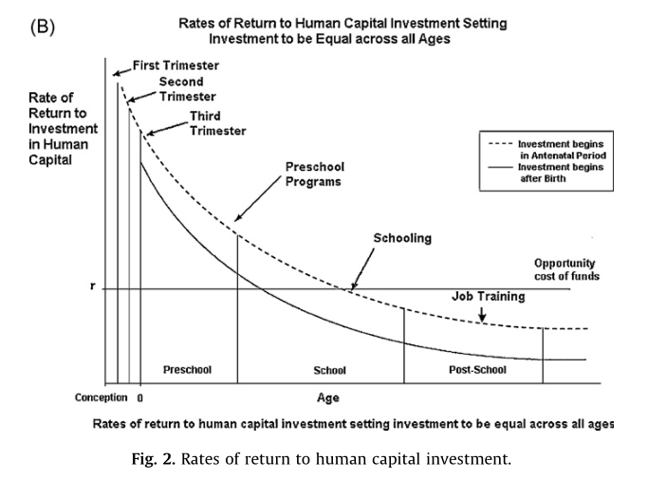
Investing in ECD programmes
Better health
Lower rates of delinquency and crime
Better success in education
Higher annual income

Slide 19
Early childhood offers an opportunity to shape the trajectory of a child's holistic development as well as an opportunity to build a foundation for their future.
In order for children to reach their full potential, they need:
health care and nutrition,
protection from injuries and a sense of safety
early learning and care opportunities
All of the above is necessary to nourish the developing brain and to propel the developing body.

Slide 20
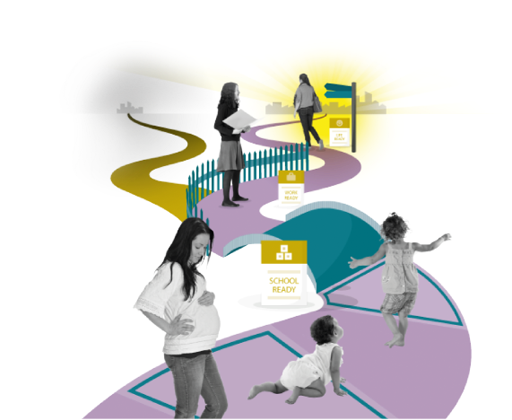
Availability of early support systems
The share of children who are at risk and have difficulties and disabilities in the total number of preschool children is estimated at 16.1%, (one in six children).
The percentage of children with developmental disabilities is higher in:
poor families,
families with mothers who have lower levels of education,
outside urban areas, and
children who did not attend educational institutions in their early life

Slide 21
Reacting at an early age is the answer... because later it becomes increasingly difficult to fix problems.
When a child's brain does not get what it expects and needs, especially during the most sensitive and rapid periods of early childhood development, the effort required to correct it later in life is enormous, and obtaining optimal results is extremely unlikely.
The depth and severity of problems later in life associated with deprivation in early childhood can be corrected by means of early reaction.

Slide 22
For many millions of the most vulnerable children in the world, we often miss this opportunity.

Slide 23
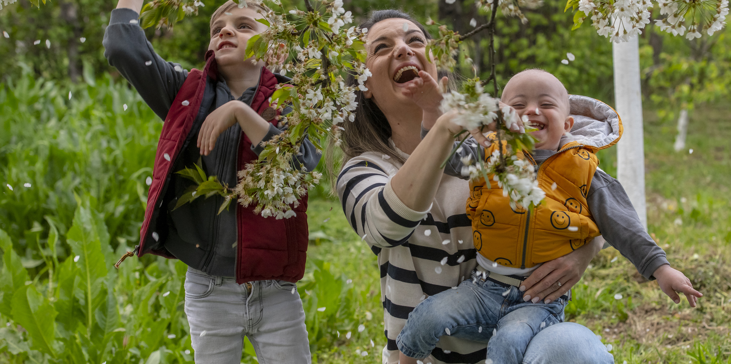
Thank you for your attention

