Slide 1








Worskhop 3: Early identification of developmental difficulties in children
Moderator: Aleksandra Jovic, UNICEF ECARO
Speakers:
Revan Mustafayev, UNICEF, WHO
Dr Shkelzen Marku, Partnership for Development Foundation (PfD)
Mirella Giannakopoulou and Ioanna Karavaggeli, Theotokos Foundation
#FamilyCentredECI

Slide 2

Early identification of developmental difficulties
Revan Mustafa
International Developmental Pediatrics Association
#FamilyCentredECI
Notes:
Good afternoon, Mirembrama to everyone
My kind greetings to everyone,
I am Revan Mustafa from International Developmental Pediatrics Association, and would like to share with you our vision and experience on the identification of developmental difficulties

Slide 3



Child healthcare in ECARO
Early identification of developmental difficulties is largely not happening in health systems
Generally, parents of children with developmental difficulties are trying to ’get the attention’ of primary health care providers (PHP)
Parental concerns are not taken seriously, PHP generally ‘wait and see’
Parents initiate self-referrals, and demand services
Early intervention programs receive few referrals from places like NICU, hospitals
Vargas-Baron E, Diehl K, Kakabadze N, Bouillet D, Miljevic-Ridicki R, Moran MA. Situational Analysis of Early Childhood Intervention Programmes in Croatia. 2020. RISE Institute: Washington DC.
#FamilyCentredECI
Notes:
The sad truth is that early identification is not happening in health systems

Slide 4
Child healthcare in ECARO
No doubt that child development is the job of healthcare
The only system that can reach all young children and their families
Even starting from when they plan to have a child
Health systems are contacted regularly during early childhood
Healthcare providers are trusted in the community
Ertem IO & World Health Organization. Developmental difficulties in early childhood: prevention, early identification, assessment and intervention in low-and middle-income countries: a review. World Health Organization publications; 2012.
Engle PL, Young ME, Tamburlini G. The role of the health sector in Early Childhood Development. In: Handbook of Early Childhood Development Research and its impact on global policy. Eds: Britto PB, Engle PL, Super CM. New York, 2013, Oxford Academic.
#FamilyCentredECI
Notes:
There is no doubt that child development needs to be addressed within healthcare

Slide 5
Child healthcare in ECARO
A well-developed primary health care infrastructure
Which is accessible, population is well covered with basic services
The main PHP are physician and a nurse: they are trusted in the communities.
An average number of PHP-child contacts under 3 is around 12-14 (max 42)
Many countries have a home-visiting system
What is the problem?
Ertem IO & World Health Organization. Developmental difficulties in early childhood: prevention, early identification, assessment and intervention in low-and middle-income countries: a review. World Health Organization publications; 2012.
#FamilyCentredECI
Notes:
Let me try explain why this might be the case.

Slide 6
Developmental monitoring
To keep track of, and support each child’s development
Not a test nor a single skill
A set of coherent competencies
  Promote and support child development
  Identify developmental problems early
  Assess and address health-related and psychosocial risks
  Intervene early
Dworkin PH. British and American recommendations for developmental monitoring: the role of surveillance. Pediatrics, 1989. 84(6), 1000–1010.
Ertem IO & World Health Organization. Developmental difficulties in early childhood: prevention, early identification, assessment and intervention in low-and middle-income countries: a review. World Health Organization publications; 2012.
Ertem IO. The International Guide for Monitoring Child Development: enabling individualised interventions. Early Childhood Matters. 2017:83-7.
#FamilyCentredECI
Notes:
Let me try explain why this might be the case.

Slide 7

Developmental difficulties
17% of pediatric population
Visible developmental difficulties: cerebral palsy, Down syndrome, some chronic diseases
Invisible developmental difficulties: Psychosocial risks,
autism, speech delay, hearing loss
Developmental difficulties
Optimal development
Ertem IO & World Health Organization. Developmental difficulties in early childhood: prevention, early identification, assessment and intervention in low-and middle-income countries: a review. World Health Organization publications; 2012.
Zablotsky B, Black LI, Maenner MJ, Schieve LA, Danielson ML, Bitsko RH et al. Prevalence and trends of developmental disabilities among children in the United States: 2009-2017. Pediatrics. 2019;144(4):e20190811. doi: 10.1542/peds.2019-0811.
#FamilyCentredECI
Notes:
When we look at the developmental difficulties from the contemporary theory of child development, we can certainly say that there does not exist a clear cut boundary between where optimal development ends and developmental difficulties start. It is rather a continuum along a spectrum where there is optimal development, no delay but risks, delay which you can not readily observe, and obviıous disability.
Thus, children who obviously have developmental difficulties are only a tip of an iceberg.

Slide 8
Phenylketounuria
Child development
Screening
Monitoring
#FamilyCentredECI
Notes:
Screening is not appropriate for child development, it is appropriate for Yes or No conditions.
The aim of finding a developmental difficulty is not just to find it, but maximize the development by promoting nurturing care, supporting development, addressing risks

Slide 9

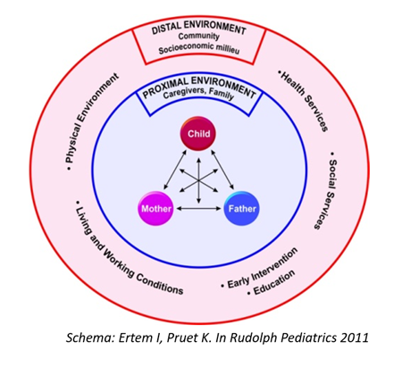
Acknowledge the importance of family
Children develop in relationships-family, community, country, world.
We must be in this relationship.
We must apply principles of family-centered care
Urie Bronfenbrenner
1917-2005
Bronfenbrenner U, Ceci SJ. Nature-nurture reconceptualized in developmental perspective: a bioecological model. Psychol Rev. 1994;101:568-86.
Committee on Hospital Care ve Institute for Patient- and Family-Centered Care. Patient- and family-centered care and the pediatrician's role. Pediatrics, 2012; 129(2), 394–404.
Ertem I, Dogan DG, Srinivasan R, Yousafzai AK, Krishnamurthy V. Addressing early childhood development in healthcare: putting theory into practice. BMJ Paediatr Open. 2022;6(1):e001743. doi: 10.1136/bmjpo-2022-001743.
#FamilyCentredECI
9
Notes:
You will use theory name later. Mention briefly here. Emphasis on bio psycho social

Slide 10
Ask parental concerns
Numerous research has shown that parental concern is an indication of a developmental problem unless proven otherwise.
PHP often do not ask parental concerns about development, do not take concerns seriously, and instead ‘wait and see.’
Glascoe FP, Altemeier WA, MacLean WE. The Importance of Parents' Concerns About Their Child's Development. Am J Dis Child. 1989;143(8):955–958. doi:10.1001/archpedi.1989.02150200115029
Ristovska AK, Filipovska M, Ajdinski G, Cjichevska-Iovanova N, Dmimitrova-Radojichikj D, Rashikj-Canevska et al. Situational Analysis of Early Childhood Intervention in the Republic of North Macedonia. 2022.
Vargas-Baron E, Diehl K, Kakabadze N, Bouillet D, Miljevic-Ridicki R, Moran MA. Situational Analysis of Early Childhood Intervention Programmes in Croatia. 2020. RISE Institute: Washington DC.
#FamilyCentredECI
Notes:
Put simple, healthcare providers do not know about child development, and do not know what to do

Slide 11
Provide a holistic assessment of development
We must use standardized validated tools
At regular intervals and whenever there is a parental concern
Ertem IO & World Health Organization. Developmental difficulties in early childhood: prevention, early identification, assessment and intervention in low-and middle-income countries: a review. World Health Organization publications; 2012.
Lipkin PH et al. Promoting Optimal Development: Identifying Infants and Young Children With Developmental Disorders Through Developmental Surveillance and Screening. Pediatrics January 2020; 145 (1): e20193449. 10.1542/peds.2019-3449
#FamilyCentredECI

Slide 12
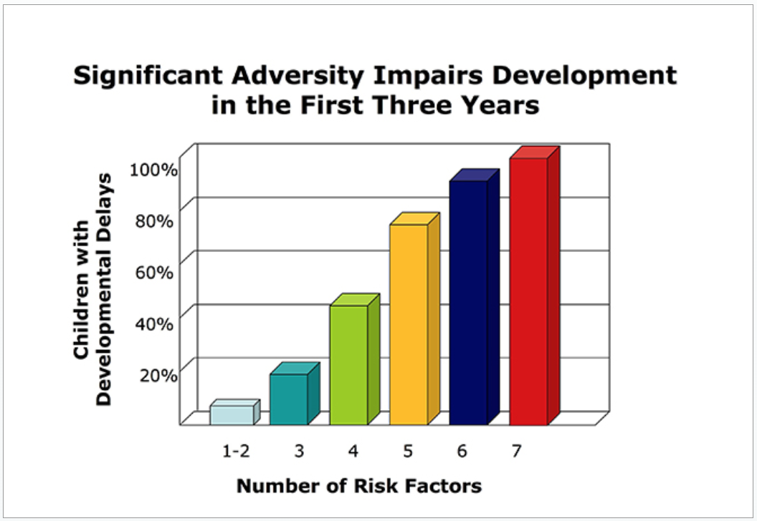
Decrease risks, increase protective factors
Developmental trajectory
Decrease risks
Increase
protective
factors
and
resilience
Barth RP, Scarborough A, Lloyd EC, Losby J, Casanueva C, Mann T. Developmental Status and Early Intervention Service Needs of Maltreated Children. Washington, DC: U.S. Department of Health and Human Services, Office of the Assistant Secretary for Planning and Evaluation; 2007.
Ertem IO & World Health Organization. Developmental difficulties in early childhood: prevention, early identification, assessment and intervention in low-and middle-income countries: a review. World Health Organization publications; 2012.
#FamilyCentredECI

Slide 13
Ensure seamless transition to early intervention
It is not enough to identify early unless children and families start intervention early
Only a small proportion of children who are identified with developmental difficulties receive timely EI because of the disruptions in the continuity of care.
Ertem IO. Developmental Difficulties in Early Childhood. WHO Publications 2012
Kuo AA, Inkelas M, Maidenberg M, Lotstein DS, Samson KM, Halfon N. Pediatricians' roles in the provision of developmental services: an international study. J Dev Behav Pediatr. 2009
Marks KP, Glascoe FP. USPSTF Did Not "Connect the Dots" Between Early Detection and Intervention. Pediatrics. 2016
#FamilyCentredECI
Notes:
There is no doubt this needs to happen within healthcare

Slide 14
What needs to happen
PHP need to be trained in child development (bioecological theory, family-centered care, risks, strengths-based care)
Developmental monitoring needs to become a standard of care in healthcare
Give PHPs training, time, reimbursement, incentives, and mandate.
Adopt healthcare policy that values ECD and creates resources for developmental monitoring
Lean on facilitators
#FamilyCentredECI

Slide 15
Facilitators
Consensus on the importance of DM
The primary healthcare infrastructure: accessible, high coverage, homevisiting
WHO/UNICEF support and countries who have achieved progress
#FamilyCentredECI

Slide 16
Faleminderit! Thank you!
#FamilyCentredECI

Slide 17

UPHV using a multi-sector approach
Dr. Shkelzen Marku

Slide 18
Brief introduction
UNICEF has supported the MOHSP to develop a comprehensive regulatory framework for preventive maternal, new-born, and child health services which includes:
  service guidelines and protocols (for antenatal care, postnatal care, mother and child nutrition, child development) as well as;
  revised maternal & child health chapters of Basic Package for PHC Services
A set of legal acts and the Health Sector Strategy 2016-2020, have placed the emphasis on maternal and child health and prioritized Roma, Egyptian children and children with disabilities.

Slide 19
A multi year intervention
Institutional development support for quality & inclusive health services …
  aiming to foster development of mechanisms, instruments and capacities for implementation of UPHV and enforcement of the M&CH regulatory framework:
    piloted in Durres and Shijak municipalities (2016-2017)
    went to Tirana, Elbasan, Korca and Vlora municipalities (2019-2022)
    expanded to Lezha municipality in 2022
    now expanded to 7 regions in 2023

Slide 20
Key intervention areas
Development of mechanisms and instruments within regional health department for implementing UPHV and regulatory framework;
Strengthening the capacities of PHC personnel for implementation of:
  the M&CH regulatory framework and the basic package of primary child health care services;
  the UPHV (targeting especially the most vulnerable and at-risk families and children) based on national protocols and UPHV methodology developed by UNICEF ECARO
Strengthening capacities for supportive supervision of PHC personnel during implementation of UPHV
Strengthening intersectoral cooperation and referring system

Slide 21
Developing instruments & tools
Competency profiles of the personnel working in mother and child consulting centres, based on the basic package of PHC services;
Guidelines and standards for UPH visiting
Detailed practical forms/checklists for the home visiting by age groups
Supportive supervision guidelines

Slide 22
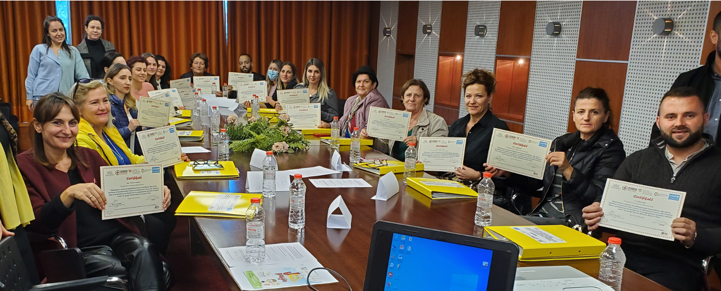
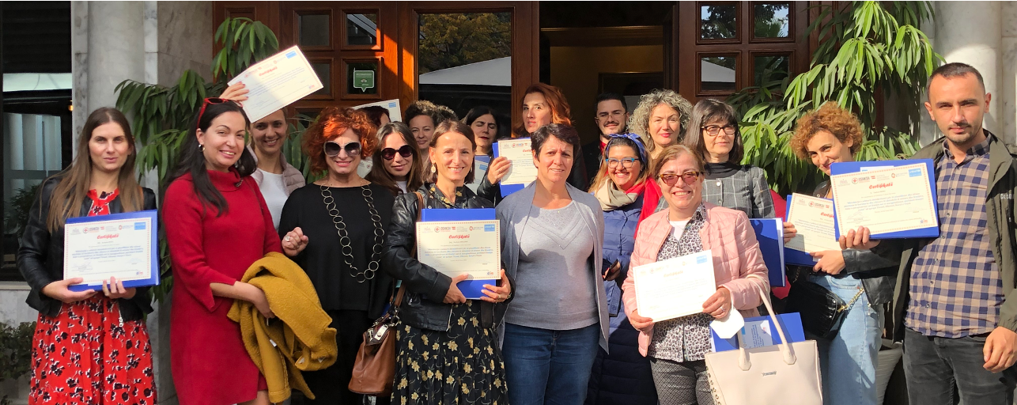
Strengthening capacities for UPHV
368 health personnel received accredited trainings (in Tirana, Elbasan, Korça, Vlora, Lezha)
  Of which:
    279 Nurses
    89 Doctors
50 supportive supervisors received accredited trainings

Slide 23
Implementation of UPHV (until Dec.22)

Slide 24
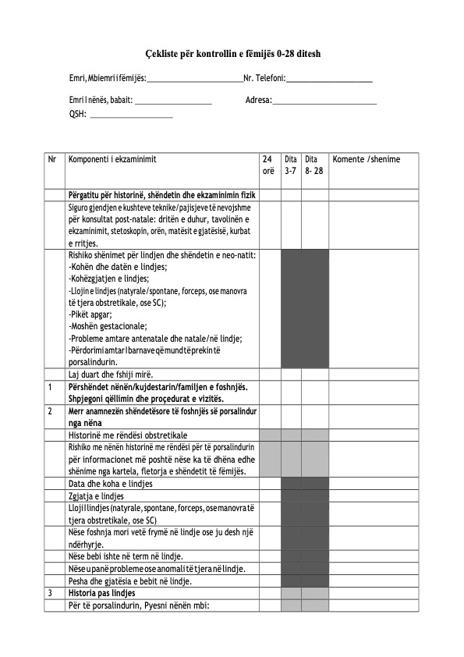
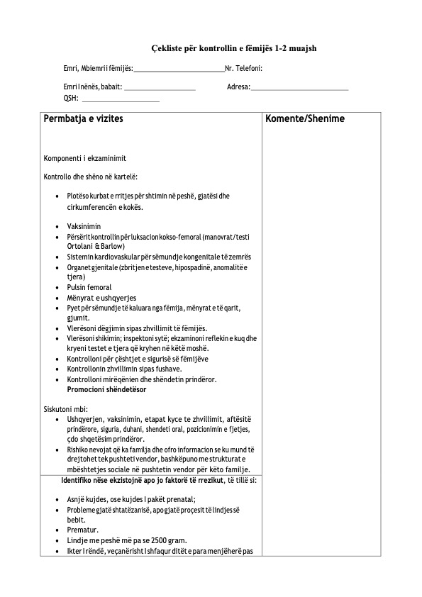
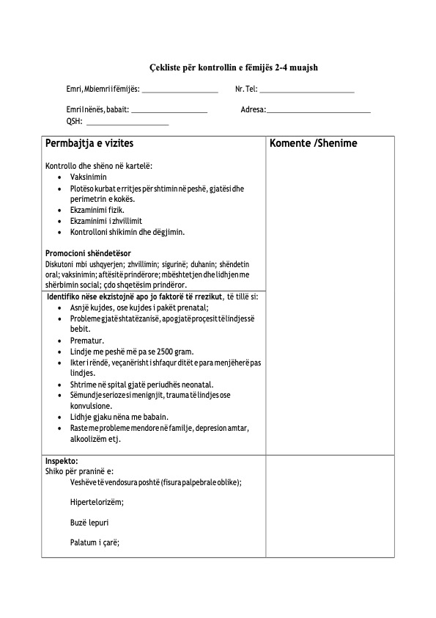
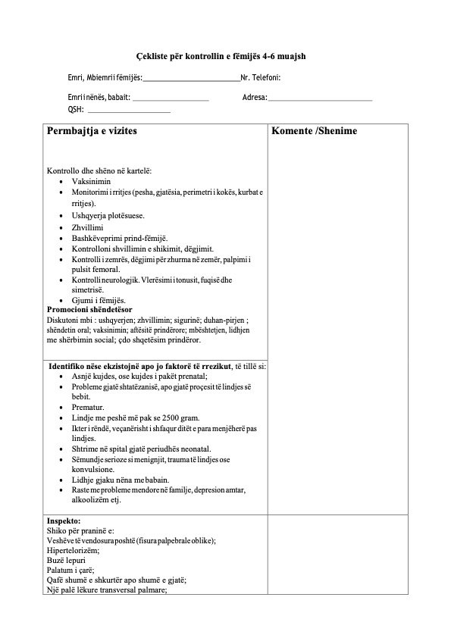
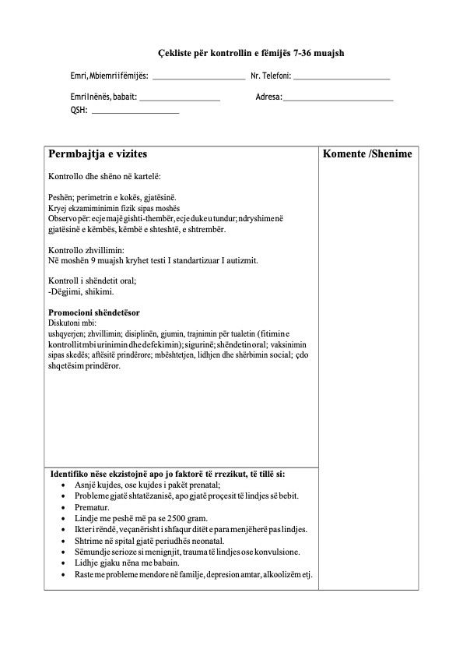
Detection of developmental delays
Assess the situation and development (based on guidelines and standards for UPHV) using:
  practical instruments (multifunctional inspection checklists, growth charts, etc.)
  and list of developmental milestones
Combined with their own continues clinical training/experience
For children 0-28 days
For children 1-2 months
For children 3-4 months
For children 4-6 months
For children 7-36 months
Checklists

Slide 25
Problematic cases identified
709 problematic cases identified, of which 91 severe cases until Dec.22

Slide 26
Heatmap of identified cases

Slide 27
Heatmap of identified cases

Slide 28
Referral of most severe cases
About 58% of severe cases referred have been successfully delt with by respective institutions
About 42% of cases are still in process

Slide 29
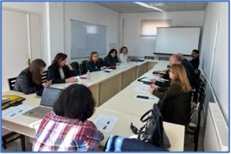
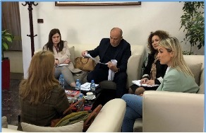
Intersectoral cooperation
Cooperation at higher decision making levels
Cooperation at the municipality level
Cooperation at the local level (LAU)

Slide 30
Key take aways
PHC personnel (especially nurses) are most positioned to early detect the problematic cases of risk in child growth and development during the UPHV;
To do so, PHC personnel need to be trained and equipped with standardized instruments and practical tools for identification, documentation and referral;
Inclusive childcare needs a combination of holistic public health approach and family centred care approach, contributing to strengthening both parents and communities;
Intersectoral cooperation is a must: childcare for sound and safe child growth and development needs active engagement and contribution of many sectors.

Slide 31


“ECI in the Community” Early identification programme
Mirella Giannakopoulou,
MSc Special Educator
Head of ECI Department, Theotokos Foundation
Ioanna Karavaggeli,
MSc Speech and Language Therapist,
ECI Department, Theotokos Foundation
#FamilyCentredECI

Slide 32
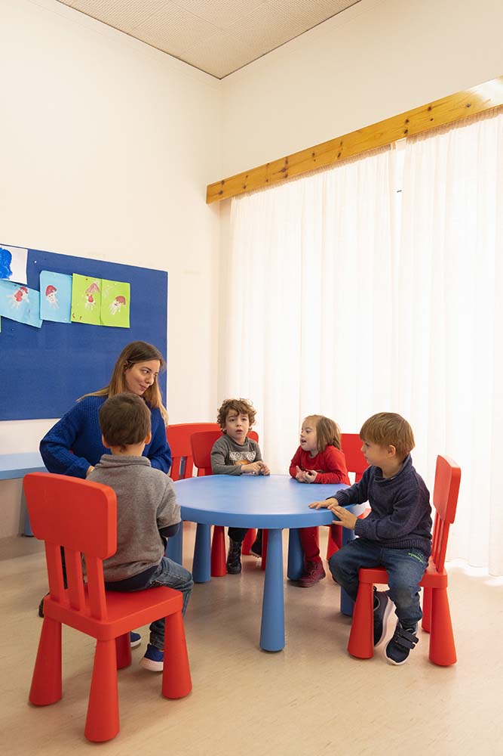
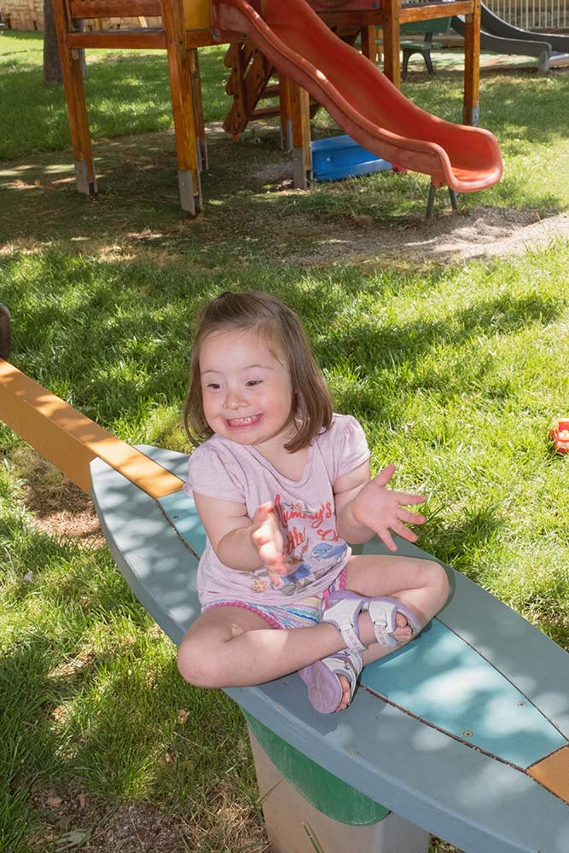



#FamilyCentredECI

Slide 33
Our Philosophy
Identification
Diagnosis
Family- Centred Intervention
School Environment
#FamilyCentredECI

Slide 34


Why “ECI in the Community”?
Late referral
Lack of a unified institutionalized ECI framework
Absence of formal referral procedure for children at risk
Absence of mapping of certified ECI service providers
Absence of institutionalized services for families and children under 2;0 years with disabilities
#FamilyCentredECI

Slide 35
What is “ECI in the Community”?
“ECI in the Community” is a programme conducted by the ECI Department of Theotokos Foundation, since 2016
It is a cooperation of Theotokos Foundation and the neighboring Municipalities Ilion and Kamatero
From 2016- 2019, 12 nurseries of Municipality of Ilion participated in the programme
From 2019- today, 8 nurseries of Municipality of Kamatero were added (20 nurseries in total)
#FamilyCentredECI

Slide 36
What is “ECI in the Community”?
Target group children 1;5-4;0 years and their families
2633 children and their families have received assessment and counselling services from specialized therapists
2017-2019, the programme received funding from Region of Attica
2019- today, Theotokos Foundation is running the programme on own resources
#FamilyCentredECI

Slide 37
Why is “ECI in the Community important?
Availability
Proximity
Cost free Services
Interdisciplinary Team
Variety of Services
European Agency for the Development of Special Needs Education, 2004
#FamilyCentredECI

Slide 38
Trandisciplinary team
Family
Theotokos Foundation
Educational Staff
#FamilyCentredECI

Slide 39
Child and Family Centred Approach
COMMUNITY
SPECIALISTS
SCHOOL
CHILD
FAMILY
#FamilyCentredECI

Slide 40
Objectives of the programme
Early detection and intervention in the community for preschool children at risk and their families in order to:
Ensure/enhance children’s development
Empower families
Support teachers
Achieve social and school inclusion
Promote de- institualization
#FamilyCentredECI

Slide 41
Methodology
PHASE 4 Consultation with parents
PHASE 1 Awareness
PHASE 2
Screening
PHASE 3 Identification
PHASE 5 Diagnosis
PHASE 6 Intervention
#FamilyCentredECI

Slide 42

Phase 1: Awareness
Conducting meetings with:
Mayor
Educational staff of kindergartens
Municipality Scientific Staff
Parents
#FamilyCentredECI

Slide 43
Phase 2: Screening
Achenbach Child Behavior Checklist (parents and childcare teachers)
Questionnaire which concerns adaptive and maladaptive behavior for children aged between 1;5- 5;0 years old. Two types of questionnaires:
Questionnaire for parents
Questionnaire for teachers
Modified Checklist for Autism in Toddlers (M-CHAT)
Speech and Language Development Questionnaire (SL Department of Theotokos Foundation)
#FamilyCentredECI

Slide 44
#FamilyCentredECI

Slide 45
Categories following questionnaires analysis
Group 1:
Group 2:
Group 3:
No difficulties
  Parents in need of information about development and/or parenting
  Children with an indication of risk for developmental delay or psychosocial and emotional difficulties
#FamilyCentredECI

Slide 46
#FamilyCentredECI

Slide 47
Phase 3: Identification in the nurseries
Denver Developmental Screening Test
AnOmiLo4 Speech & Language Screening Test
Preschool Language Scale 4- PLS 4
Early Sociocognitive Battery (ESB)
Clinical Examination by Psychologist/SLT/ OT
Classroom Observation
#FamilyCentredECI

Slide 48
Phase 4: Consultation with parents
Family History
Verbal report on child’s level of performance during the assessment at the nursery
Specialists and family decide jointly if child will be referred for further assessment
#FamilyCentredECI

Slide 49
Identification
Group 1:
No difficulities
Group 2:
Mild difficulties
Group 3: Developmental/Socio-Emotional Difficulties
Discharge
Diagnosis/assessment at Theotokos Foundation
  Discharge
Follow up in a year
Attend psycho- educational parent group
Referral to public services for diagnosis/assessment
#FamilyCentredECI

Slide 50
Phase 5: Diagnosis
Pediatrician – Developmental Pediatrician
Child- Psychiatrist
Clinical Psychologist/ Developmental Psychologist
Speech and Language Therapist
Occupational Therapist
Social Worker
#FamilyCentredECI

Slide 51
Phase 6: Intervention
Intervention
School Environment
SLT sessions
OT sessions
Theotokos
Foundation
ECI Department
Family Consultation
School Invironment
#FamilyCentredECI

Slide 52
ECI Greece Project
ECI Greece Project is implemented by the Greek Ministry of Labour and Social Affairs with the technical support of European Association of Service providers for Persons with Disabilities (EASPD) and the European Commission
The ECI Greece project aims at supporting the Greek government in developing a modern, evidence-based legislative and financial framework for early childhood intervention services
Theotokos Foundation is one of the Pilot Service Providers Organizations that will implement family centered methodology
#FamilyCentredECI

Slide 53


#FamilyCentredECI

Slide 54
Future thoughts
Increase community awareness
Group training for educational staff
Handbooks on:
- Methodology
- Training parents
- Training educational staff
Implementing the program to other Municipalities in Athens
#FamilyCentredECI

Slide 55
THANK YOU
mgiannakopoulou@theotokos.gr
ikaravaggeli@theotokos.gr

