Slide 1





Workshop 2: The correlation between employee’s wellbeing and service quality
Moderator
James Churchill
#QualitySocialServices

Slide 2

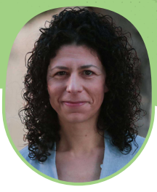
Speakers
  Shereen Hussein, London School of Hygiene and Tropical Medicine, UK
  Marita Galea, People & Standards Division, Malta
#QualitySocialServices

Slide 3



Social Service Employees’ Wellbeing & the impact of the Pandemic: A case study of the UK
Shereen Hussein
Professor of Health & Social Care Policy
London School of Hygiene and Tropical Medicine
United Kingdom

Slide 4
Structure of the presentation
How workers’ well-being is conceptually linked to the quality of services
What is social services workers’ well-being at work
  Its dimensions and how it is shaped
  Drawing from a recent study developing a scale specific to this type of work (Hussein et al., 2022)
What additional pressures did the COVID-19 pandemic pause on the workforce
  Drawing on a current study in the UK, RESSCW (e.g. Saloniki et al., 2022)
Policy and practical implications

Slide 5
The Links Between Workers’ Well-being and Quality of Services
Recruitment & retention
Attracting talents
Productivity
Quality of relations & users’ satisfaction
EASPD Conference, Malta, Oct 22 @DrShereeHussein; shereen.hussein@LSHTM.ac.uk

Slide 6
STUDY 1:
Developing a scale to measure care workers’ wellbeing at work
Hussein, S., Towers, A-M., Palmer, S., Brookes, N., Silarova, B., Mäkelä, P. (2022). Developing a Scale of Care Work-Related Quality of Life (CWRQoL) for Long-Term Care Workers in England. International Journal of Environmental Research and Public Health. 19(2): 945. https://doi.org/10.3390/ijerph19020945
This project was funded by the National Institute for Health Research (NIHR) 2019-2021; (Grant Reference Number NIHR200070). PI: Shereen Hussein. Research Team: Ann-Marie Towers, Sinead Palmer, Nadia Brookes, Barbora Silarova (University of Kent) and and Petra Mäkelä (LSHTM)

Slide 7
Social Services Workers’ Well-being at Work
Have several dimensions
  For example: emotional, physical and financial
Affected by work-related factors that are similar to other work
  For example, pay and working conditions
Affected by a unique set of features related to care work
  The relational nature of care work
  How care work is organised and rewarded
  How the society perceive the importance of such work

Slide 8
Professional identity
Societal recognition of care work
Valued
Staffing
Social Wellbeing
Management & Supervision
Emotional Wellbeing
Care Organisation Characteristics
Environment
Environmental Wellbeing
Spill over
Wellbeing in
life beyond
care work
Training & Development
Financial Wellbeing
Pay & Benefits
Physical Wellbeing
Time
Relations
Nature of Care Work
Tasks
Source: Hussein et al. (2022)
Clients’ needs

Slide 9
Domains, Subdomains & items
Financial Wellbeing
2 sub-domains: 1 -Job security; 2 - Having enough money to meet needs
Mental Wellbeing
3 sub-domains (6 items) : 1- Burnout/exhaustion (3 items); 2- Satisfaction/motivations (2 items); 3- Impact of clients’ loss (1 item)
Organisational Features
5 sub-domains (11 items): 1- Sufficient staffing (1 item); 2- Management & supervision (3 items); 3- Working environment (2 items); 4- Training & Development (4 items); 5 – Pay & Benefits (1 item)
Nature of care work
4 sub-domains (16 items): 1- Time (4 items); 2- Relations (5 items); 3- Tasks & Responsibilities (5 items); 4- Care client’s needs (2 items)
Recognition of Care Work
2 sub-domains (5 items): 1- Feeling valued and respected by (4 items); 2- Professional identity
Physical Wellbeing
4 sub-domains: Physical injuries; Adequate equipment to do work; Physical health (aches & pains); Impact on health behaviour (sleep, diet)
Work-life spill-over
3 sub-domains: 1- Work limits out of work activities; 2- Positive mood from work improves personal life; 3- Negative work-related thoughts stays out of work
Notes:
Core domains and items- 40% agreement
Both negative and positive directions
Potential interaction/ overlap – next stage of work; item reduction etc.

Slide 10
Impact on care workers
Mental/emotional wellbeing
I occasionally just kind of get compassion fatigue, and a kind of , not overwhelmed, but I get kind of like burnt out from they ask a lot from us emotionally (CW, community support, male)
Physical wellbeing
There are periods when it is all consuming and it’s all I can think about and I don’t sleep, I don’t eat properly, I stop exercising (Care manager, community support, male)
Financial wellbeing
Low pay – inability to have financially secure life[…] Better pay so I do not have to pick up so much overtime to have enough money to provide my needs. (CW, care home, female)
Spillover from work to home
I can’t remember having a holiday, or it’s been a long time since I have actually had a holiday where I haven’t been interrupted whilst being away ….because you’re kind of waiting for that phone call to come through (FG, manager, care home, female)

Slide 11

Content validity of domains and effect of COVID19
Order of importance:
1. Financial wellbeing
2. Mental wellbeing*
3= Features of the organisation/employer
4= What care workers do in their jobs
5. Impact of work on home-life*
6. Professional identity as a care worker
7. Physical wellbeing
* shows domains most strongly endorsed for negative impact from COVID-19
*Factors
identified as
most impacted
by COVID-19
Notes:
Most strongly endorsed consequence of improving care workers’ WRQoL:
to ‘Improve overall delivery of care’ (strongly agree: 85% of respondents).
‘Most important’ factors for understanding the idea WRQoL for care workers
‘work factors outside your control, e.g. working conditions’
‘what you actually do in the job’
‘Least important’:
‘Non-work life affecting work-life’
‘personal social factors

Slide 12
STUDY 2:
The Impact of COVID19 Pandemic on the Care Workforce (RESSCW)
Saloniki, E.-C.; Turnpenny, A.; Collins, G.; Marchand, C.; Towers, A.-M.; Hussein, S. (2022). Abuse and Wellbeing of Long-Term Care Workers in the COVID-19 Era: Evidence from the UK. Sustainability, 14, 9620. https://doi.org/10.3390/su14159620
This project is part of the Retention and Sustainability of Social Care Workforce (RESSCW) study funded by Health Foundation (Efficiency Research Programme): 2019-2022. Project Team: F. Vadean & S. Hussein (Co-PIs), S. Allan, E. Saloniki, K. Gousia, A. Turnpenny, G. Collins, A.-M. Towers, A. Bryson, J. Forth, C. Marchand, D. Roland and H. Teo

Slide 13

The onset of COVID-19
What are the implications of COVID-19 on care workers’ general wellbeing, working conditions, and intentions to quit the sector?
01
Are certain workers with specific individual and work characteristics more negatively impacted by the COVID-19 pandemic?
02
Do any of these implications differ by care settings, especially between domiciliary and residential care?
03

Slide 14
COVID19 Sub-study timeline
Wave 1 analysis
engagement,
recruitment
Extra funding
Media/policy analysis,
drafting and piloting of survey
Qualitative interviews
Six social care stakeholders
Longitudinal survey
Wave 1
1,037 UK care workers
Longitudinal survey (+CS) Wave 2
754 UK care workers
‘Pulse’ survey
296 UK care workers
Mar 20
Jul-Aug 20
Oct 20
Apr-Jun 21
.....
Nov 21-Jan 22
…
.....
Analysis, design of two-wave survey, engagement, piloting, recruitment
Cross-wave analysis, dissemination

Slide 15
Survey content
Pulse survey
Jul-Aug 20
Demographics
Job-related characteristics (e.g. tenure, contract, role, setting, employer, client group)
COVID-specific topics (e.g. PPE)
Current vs. pre-COVID: employer, care setting/client group
Changes since onset of COVID: job-satisfaction-related aspects (e.g. pay, workload), intention to quit, overall job satisfaction, feelings at work, general health
Longitudinal survey: Wave 2
Nov 21-Jan 22
Longitudinal survey: Wave 1
Apr-Jun 21
Demographics
Job-related characteristics (incl. union membership)
COVID-specific topics (incl. cases and vaccine uptake)
Current/past few weeks: job-satisfaction-related aspects but extended, feelings…
Current: organisational commitment (e.g. seeking views, responding to suggestions) and job supports (e.g. respect, fair treatment, feedback)
Abuse (prevalence, type, perpetrator, action taken)
Since July 21: COVID-specific topics (incl. cases, vaccine uptake and mandate awareness)
All other topics as in Wave 1
All surveys included open-ended questions (e.g. about abuse, wellbeing support received)
Since July 21: Abuse (prevalence, type, perpetrator, action taken)

Slide 16




Wave 1: April 21 – June 21
Wave 2: November 21 – January 22
1,047 participants
84% female
5% BAME
70% direct care
54% in private sector
40% with >10yrs of experience in social care
754 participants
87% female
5% BAME
66% direct care
60% in private sector
48% with >10yrs of experience in social care
Since the start of 2021:
Since July 2021:
Among the people they work with
Among the people they work with
7 out of 10 had confirmed COVID-19 cases
among staff or clients
8 out of 10 had confirmed COVID-19 cases
among staff or clients
Had first dose of COVID-19 vaccine
Had first dose of COVID-19 vaccine
87% ✓ 9% ✗ 3% !
93% ✓ 5% ✗ 2% !

Slide 17

“Being called names, being threatened, being followed.”
Experienced in relation to COVID-19:
Direct care, adults with physical and/or sensory disability, supported living/extra care housing
reported being abused
(verbal abuse, bullying, threat or physical violence)
26%
Experienced in relation to COVID-19:
20%
11%
Verbal abuse
Bullying
“A huge amount of negative comments on social media, blaming carers for so many residents who died of covid, and blaming care homes of keeping residents hostage, unwilling to allow visits.”
7%
4%
Threat
Physical violence
Direct care, older adults, care home w or w/o nursing
Notes:
- Verbal abuse: behaviour that humiliates, degrades or otherwise indicates a lack of respect for the dignity and worth of an individual.
- Bullying: repeated and over time offensive behaviour through vindictive, cruel, or malicious attempts to humiliate or undermine an individual or groups of workers.
- Threat: promised use of physical force or power resulting in fear of harm or other negative consequences to the targeted individuals or groups.
- Physical violence (attack/assault): the use of physical force against another person or group, that results in harm.

Slide 18
Wave 1 (April-June 21) Abuse (any)
Nationality & ethnicity
Care setting
*White British vs BAME statistically significant at 5%. Remaining differences not statistically significant.
*Difference is statistically significant at 5%.

Slide 19
Pooled Data: Abuse (any)
Nationality & ethnicity
Care setting
*No statistically significant differences between any of the groups.
*Difference is statistically significant at 1%.

Slide 20
Job Satisfaction and Intention to Quit (I)
The desperately low pay, zero hours & no paid travel time is, the killer for this job. It's the most fulfilling job I have had. But I am constantly angry with the unfairness of the wages, pretence that it is unskilled labour, and so on. Which is why I can't stay.
69%
29%
very satisfied/satisfied
with job (overall)
very satisfied/satisfied
with amount of pay
Direct care, older adults and adults with physical and/or sensory disability, domiciliary care
64%
36%
We were hung out to dry , we don't want clapping support we want fair wages for an extremely difficult job , appreciation in the pay packet not standing on front doors . Jobs stacking shelves in supermarkets pay better .... how is that right?
very satisfied/satisfied
with job security
very satisfied/satisfied
with promotion prospects
Direct care, older adults, care home w or w/o nursing
I feel undervalued, definitely under paid and have been looking for other jobs, not in care.
Management, care home w or w/o nursing

Slide 21
Pulse survey – Jul-Aug 2020
  Evidence of increased workload, stress and feeling unsafe at work, decline in general health
  No COVID-19-related training for over a fifth (half for BAME respondents)*
  One in six reported not having clear guidance to be safe at work; no access to PPE
Interviews with stakeholders – Oct-Nov 2020
  High levels of anxiety amongst the social care workforce
  Social care sector felt to be abandoned in the early months of the pandemic
  Lack of understanding of the social care sector by central government
  Growing concerns about abuse of workers during the pandemic
*small number of cases for BAME respondents
Longitudinal survey (Wave 2) – Nov 21- Jan 22
  Evidence of lower job satisfaction, job supports and worse feelings at work during ‘Omicron’ wave
  Overall, males more likely to quit than females
  No significant differences in quits by care setting
  BAME respondents significantly more likely to quit current employer; weaker effect for quitting the sector
  Experienced abuse (single or multiple) negatively impacts on intention to quit
Longitudinal survey (Wave 1) – Apr-Jun 21
  Evidence of increased workload since start of 2021 (in most cases without extra pay)
  Over a third felt tense, uneasy, depressed and gloomy because of their job
  A quarter experienced abuse in relation to the pandemic (over a third for BAME)
  Abuse incidents more common in residential care
  Negative association between abuse and work-life balance; abuse and intention to quit

Slide 22
Implications
Care workers’ wellbeing
Work Structure; job satisfaction; sense of responsibility
Wellbeing at work: physical, mental and financial
Retention issues
COVID-19 combined with existing challenges
Implications on workforce outcomes and workers’ wellbeing?
Abuse: impact on wellbeing and retention
Quality of care

Slide 23
Thank you for listening
Happy to respond to questions
Shereen.Hussein@LSHTM.ac.uk
@DrShereeHussein

Slide 24
Workshop 2: The correlation between employee’s wellbeing and service quality
Marita Galea
Employee Support Service
People Support and Wellbeing Directorate
Office of the Prime Minister, Malta
#QualitySocialServices

Slide 25
The aim of Employee Support Services
To provide a support service for employees who may be experiencing personal or work-related difficulties.
Individual outcomes (wellbeing and mental health, productivity, satisfaction, morale, motivation, engagement, commitment).
Organisational outcomes (better performance, less absenteeism, less turnover, management support).
#QualitySocialServices

Slide 26
The Employee Support Service
Our service falls under the People Support and Wellbeing Directorate, which is part of the People and Standards Division within the Office of the Prime Minister. It started as an ESF project in 2011 and in 2015 it became nationally funded.
ESP Unit set up - Multi-disciplinary team of professionals – a senior practitioner, 3 social workers, a psychologist, a counsellor and a psychotherapist. Part of the team, there is also a medical board coordinator, a manager who coordinates training and events and an office assistant.
The total number of employees accessing the service to date is 2535.
#QualitySocialServices

Slide 27
The Employee Support Service
Training and awareness sessions
Individual counselling and psychological support
The medical board
Support in critical incidents
#QualitySocialServices

Slide 28
Training & Awareness Sessions
Training to management:
  Self-care, resilience and wellbeing at work;
  Mental health awareness and suicide awareness;
  Interpersonal skills and emotional intelligence.
Awareness sessions for employees:
  Self-care and resilience;
  Mental health awareness and suicide awareness;
  Emotional aspects of retirement.
#QualitySocialServices

Slide 29
Training & Awareness Sessions
Publications (quarterly newsletter, information leaflets and campaigns)
Induction programmes of new employees within the Public Service
Mental health first aid for public service employees offered by the Richmond Foundation
#QualitySocialServices

Slide 30
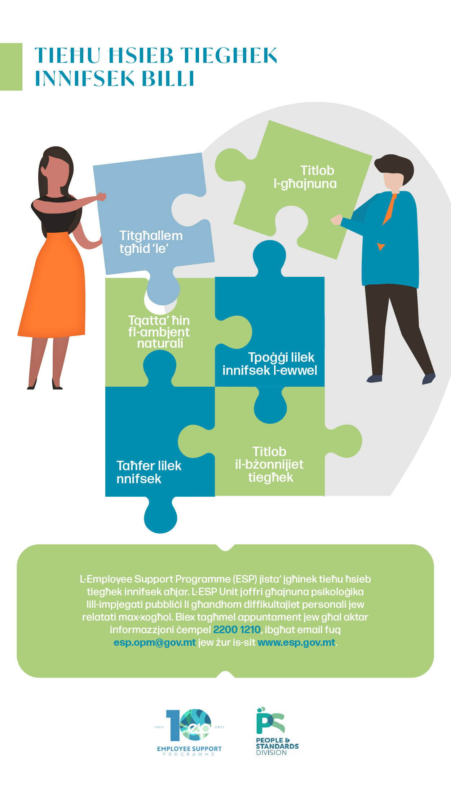
#QualitySocialServices

Slide 31

#QualitySocialServices

Slide 32

#QualitySocialServices

Slide 33
Individual counselling and psychological support
All public service employees are entitled to access the service and it is provided free of charge.
A confidential service.
Voluntary and formal referrals.
Consultation and support offered to management.
#QualitySocialServices

Slide 34
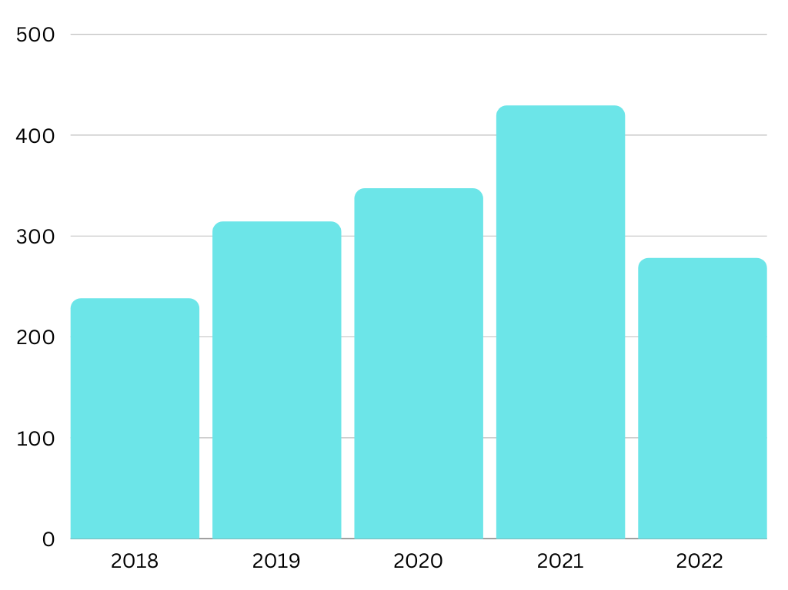
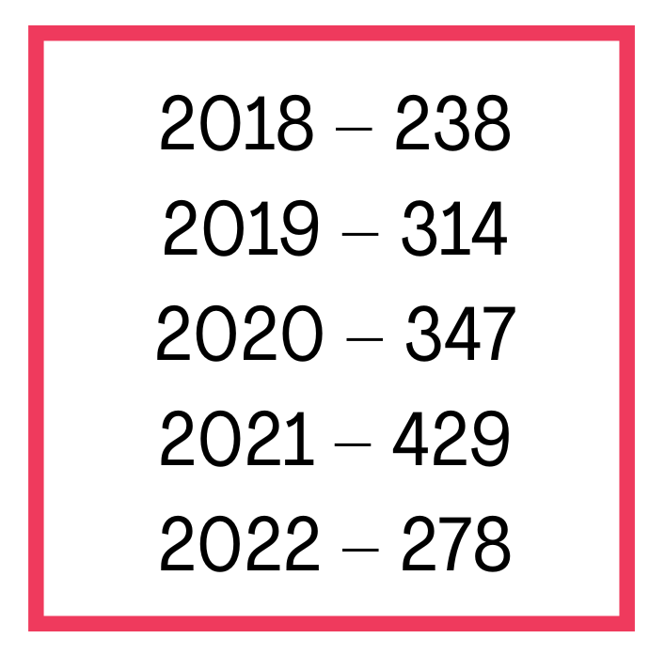
Employees Accessing the Service from 2018 – to date
#QualitySocialServices

Slide 35
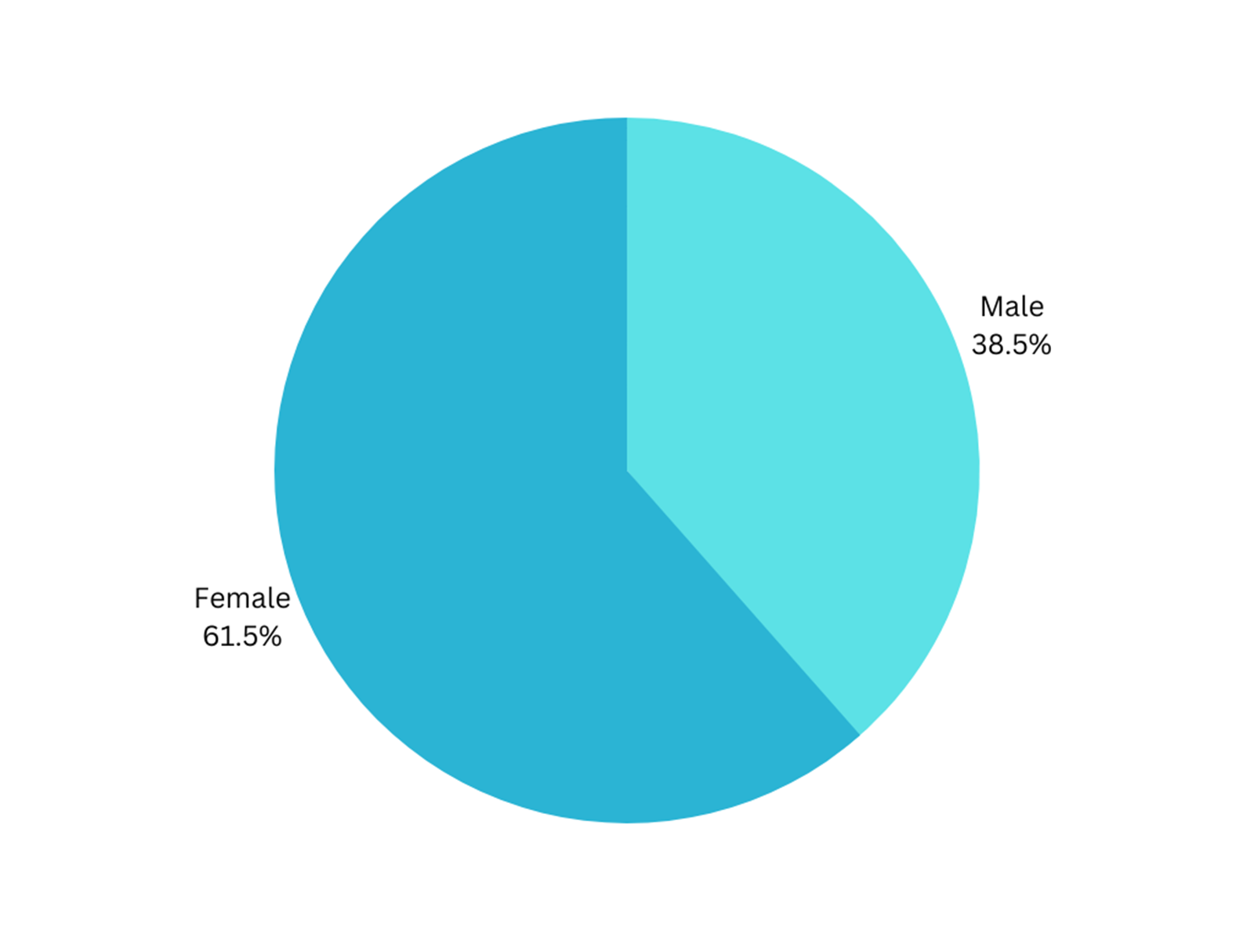
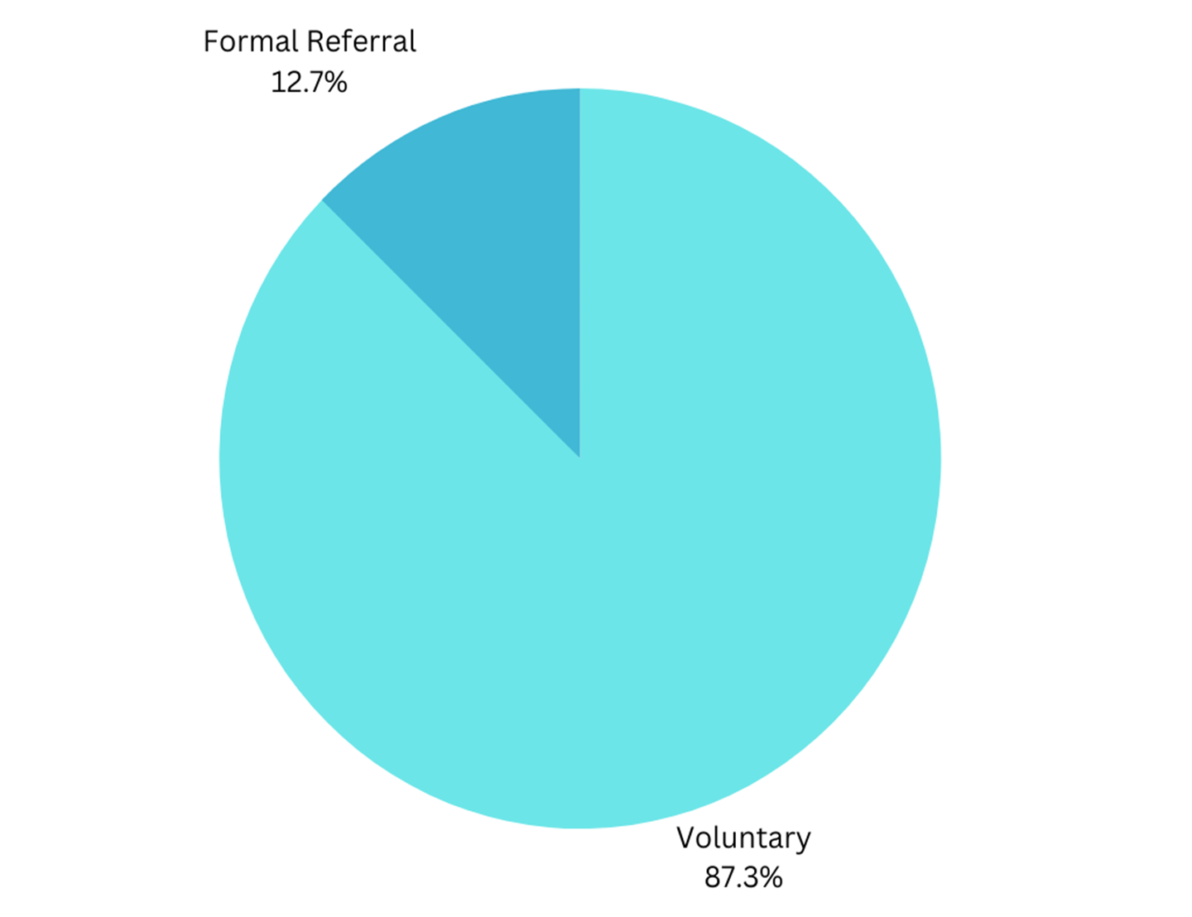
Employees Accessing the Service from 2018 – to date
#QualitySocialServices

Slide 36
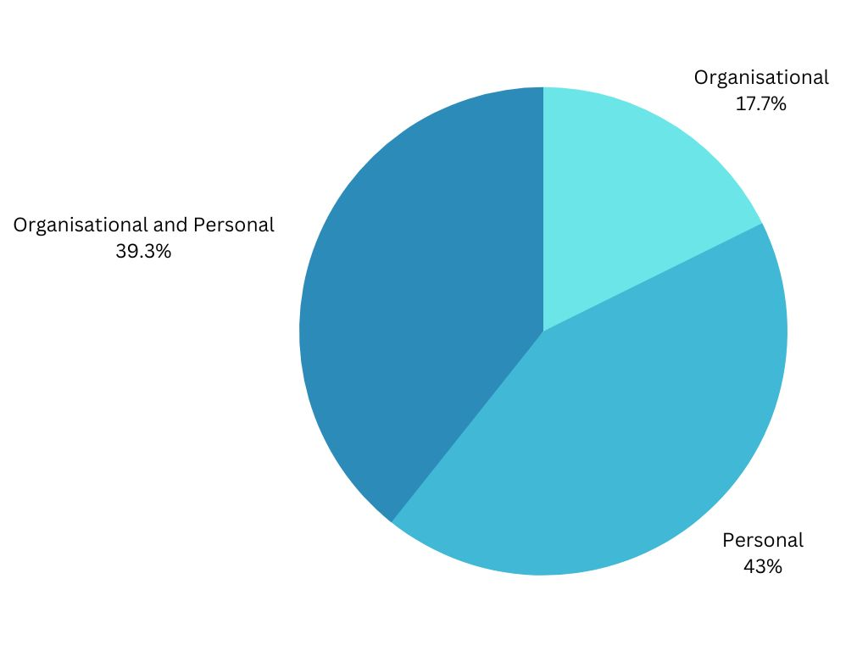
Reasons for Accessing the Service from 2018 – to date
#QualitySocialServices

Slide 37
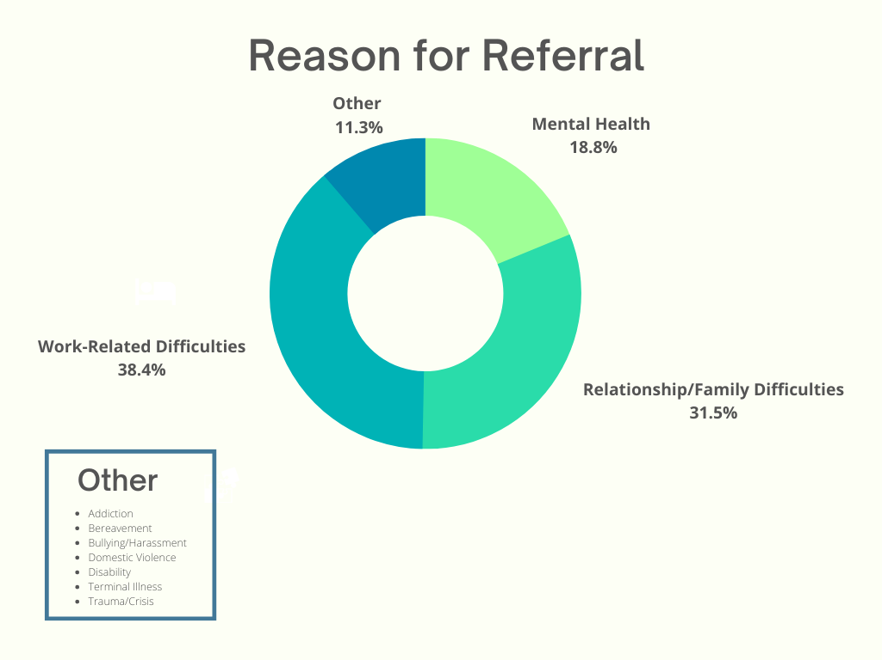
Employees Accessing the Service from 2018 – to date
#QualitySocialServices

Slide 38
Individual counselling and psychological support
Individual Support Sessions and Counselling
The aim of these sessions is to provide psychological support for those employees whose wellbeing and work performance are being affected by personal and/or work-related issues.
Support at Work
Work visits aim to support employees who may be experiencing chronic mental health difficulties and/or long-term disabilities to remain in and/or progress in their employment. Support is provided through phone calls and on-site visits to the employee.
#QualitySocialServices

Slide 39
The Medical Board
The Medical Board aims to encourage public employees to remain in employment and its primary role is to provide professional guidance and support to employees in terms of occupational health.
The board is composed of a multidisciplinary team of professionals which provide recommendations on issues related to the impact of the employee’s health issues on performance at work. Following a professional review of the case, the Medical Board will then make any necessary recommendations with a view to support the employee whilst at the same time assist management as necessary.
#QualitySocialServices

Slide 40
Critical Incident Support
The ESP provides support to departments who have experienced critical or traumatic incidents at the workplace, such as the sudden death of a colleague, violence or aggression.
In these situations, the ESP can provide both immediate support at the workplace, as well as follow-up support both to individuals and the team.
Regular support offered to employees involved in traumatic situations:
  Malta Police Force
  Armed Forces of Malta
  Civil Protection Department
#QualitySocialServices

Slide 41
What we have learnt
Management plays a crucial role in employee wellbeing.
The importance of cultivating a culture of care at the workplace – feeling valued – simple things that make a difference.
Taking care of employees is taking care of the organisation.
Personal life does affect work and in turn work also affects people’s wellbeing and their personal life.
The benefit of working in a team – the service provided is enriched by having people with different skills.
Outreach is very important – visibility.
#QualitySocialServices

Slide 42
Thank You
Phone: +356 2200 1210
Email: esp.opm@gov.mt
Website: www.esp.gov.mt
#QualitySocialServices

Slide 43
QUESTIONS?
#QualitySocialServices

Slide 44
Thank you
Panel 2 starts at 14:30 in room Casablanca
Enjoy your lunch!
#QualitySocialServices

