Slide 1
Workshop 10: EU funds for Quality? Building capacity and identifying needs
Fabiana Scarano
Junior Policy and Project Officer
fabiana.scarano@easpd.eu
#QualitySocialServices

Slide 2
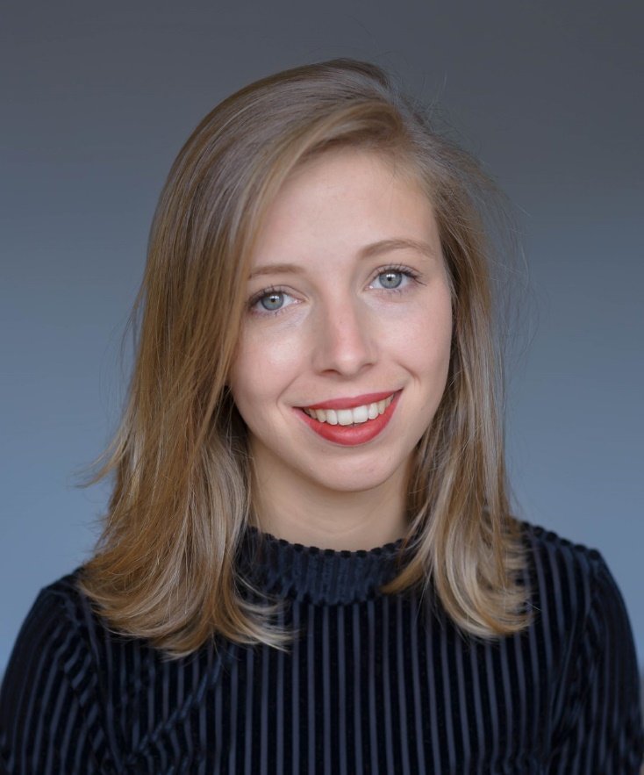
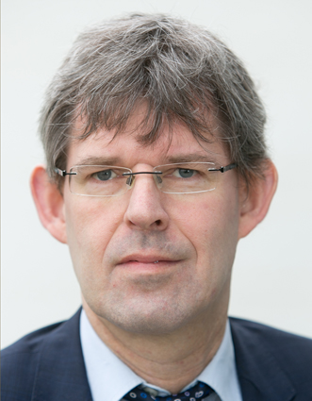
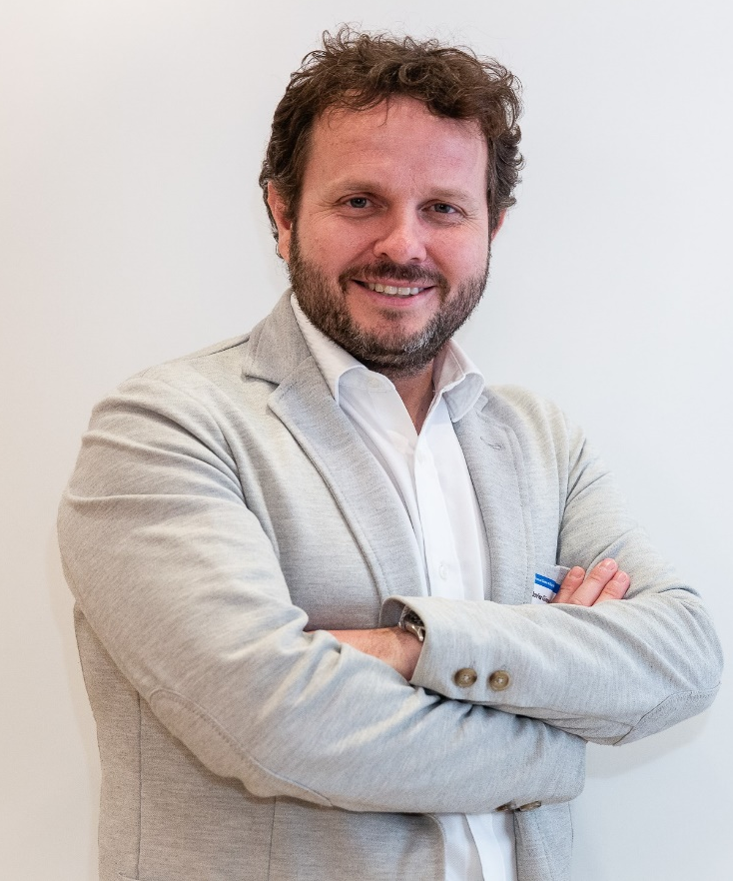
Speakers
Lilith Alink
Policy and Project Officer,
EASPD
Mathias Maucher
Policy Coordinator,
Social Services Europe
Javier Guëmes,
Director,
International Relations Office
Fundación ONCE
#QualitySocialServices

Slide 3
Agenda
09h30 | Welcome by Moderator and Introduction of Workshop speakers
09h35 | Presentation of the Helpdesk project Lilith Alink, Policy and Project Officer, EASPD
09h45 | What’s in it for social service providers? Mathias Maucher, Policy Coordinator, Social Services Europe Javier Guëmes, International Relations Office Director, Fundación ONCE
10h00 | Discussion with participants in small groups Question 1: What are the challenges social services are facing at the moment? Question 2: What do you think are the main barriers for social service providers to access EU funds? Question 3: Which are, according to you, the main training needs of social services in the use of ESF+ & ERDF and other programmes? Question 4: What are your expectations for the Helpdesk project?
10h40 | Presentation by each group
10h55 | Conclusions
11h00 | End of Workshop
#QualitySocialServices

Slide 4
10 Minutes to discuss each question
Discussion in small groups
Question 1: What are the challenges social services are facing at the moment?
Question 2: What do you think are the main barriers for social service providers to access EU funds?
Question 3: Which are, according to you, the main training needs of social services in the use of ESF+ & ERDF and other programmes?
Question 4: What are your expectations for the Helpdesk project?
#QualitySocialServices

