Slide 1

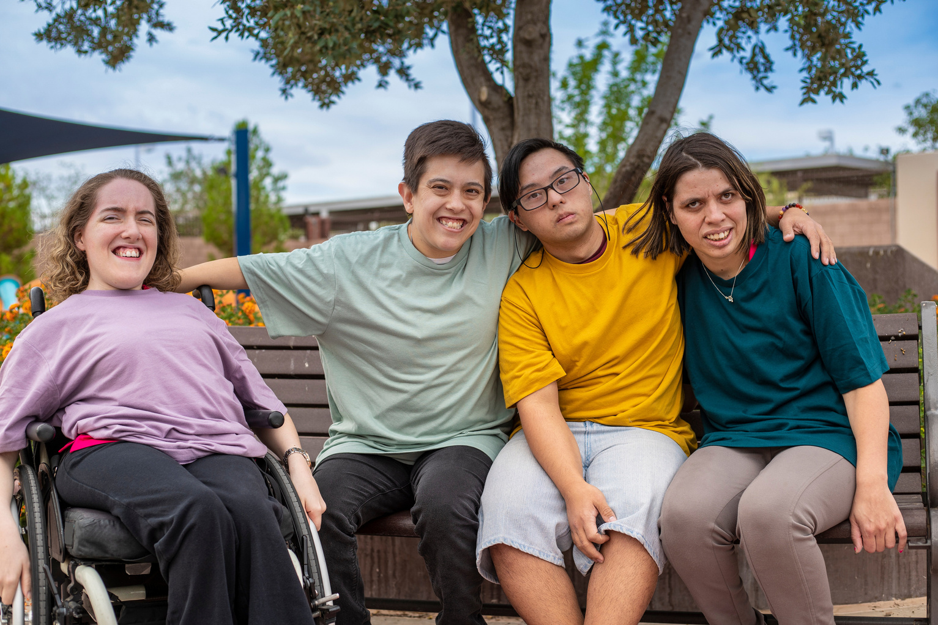





TIAP, a research to support service providers to transfer innovations
Eléonore Ségard
Bordeaux Population Health, Inserm
FIRAH
ESTOMS2021_256225 / This research has been funded by the CNSA.

Slide 2
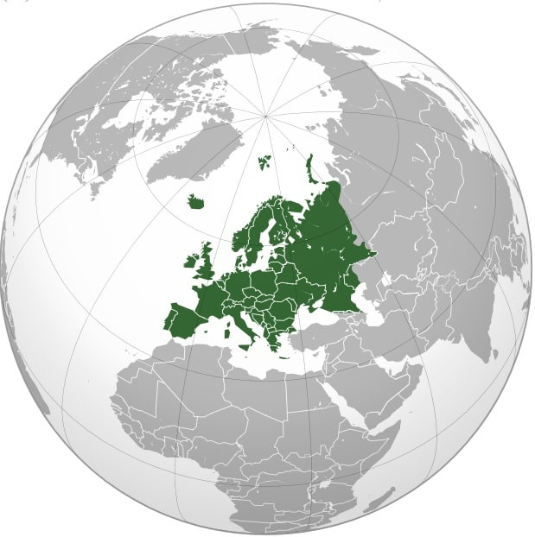

TRANSFER : to spread and speed implementation of the Convention
#Innovation4Inclusion

Slide 3
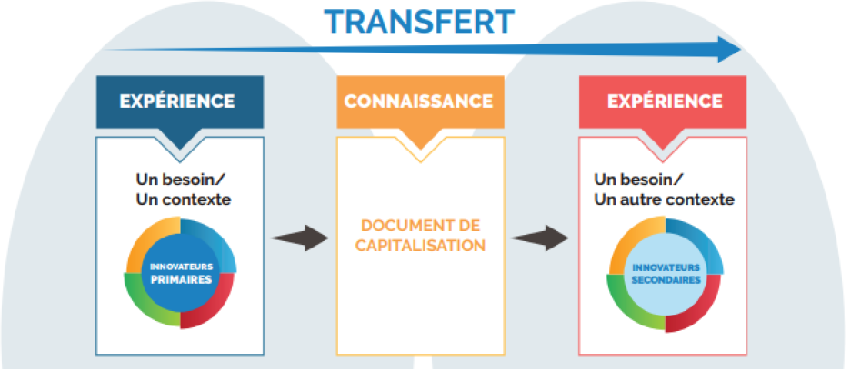

Our Framework
#Innovation4Inclusion

Slide 4
A methodological challenge
  Complexity
  Context
  Experience
  Produce useful data
?
#Innovation4Inclusion

Slide 5
TIAP : a research to address this challenge
  Aim : defining a methodology to produce knowledge in the process of transfer
  How ? By learning lessons from transferability in public health
#Innovation4Inclusion

Slide 6


Methodology
Identify components
Step 1
Elaborate
Step 2
Validate
Step 3
#Innovation4Inclusion

Slide 7

Name of Workshop 4:
Research to foster innovation in disability services
Speaker: Klaus Niederlander,
CEO Echocare BV, Netherlands
Former Director of Active & Assisted Living (AAL) Programme
#Innovation4Inclusion

Slide 8

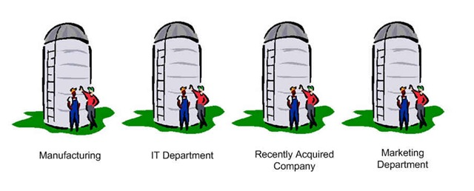
The ‘innovation’ system as many of us experience it
Research
Funding
Practice
Needs
#Innovation4Inclusion

Slide 9
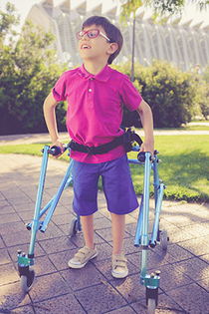



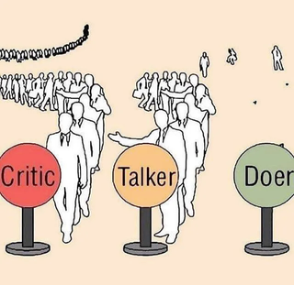

The key ingredients for an Innovation System
Needs & Aspirations
Ideas & Collaboration
#Innovation4Inclusion
‘It takes 10% Innovation & 90% Perseverance’

Slide 10



Innovation is about Continuous Learning
What purpose?
Which direction?
What positioning?
What Use Case?
What Operational Case?
What Economic Case?
Which Roles ?
Which Ecosystem?
What Structure ?
#Innovation4Inclusion

Slide 11
Doing it TOGETHER
The AAL Innovation Story
Linking Technology with People & Society
Adapting Technology & Changing
the Ageing Narrative
Co-creating
social infrastructure
  Regional health & care ecosystems as drivers
  Shared system awareness
  Culture of Collaboration
  Strategic capacity for collective action
  A continuous learning journey
  Health and Care
  Mobility & Transport
  Home & Community
  Safety and Security
  Work & Leisure
  …
#Innovation4Inclusion

Slide 12
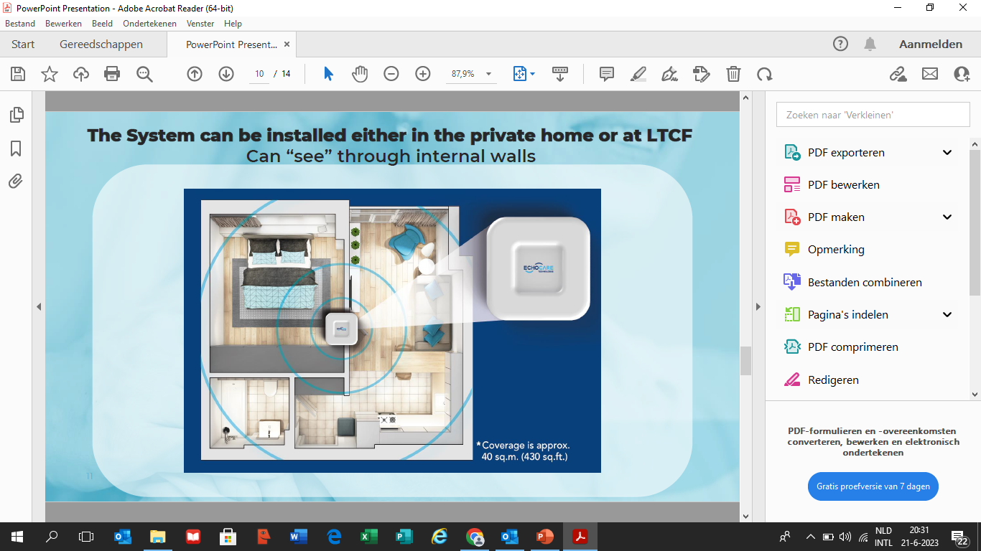

Social & Technological Innovation in Practice
My Echocare Case Study
Non-Intrusive, Non-Wearable 24/7 support
For Enhanced Safety & Well-Being
#Innovation4Inclusion

