Slide 1
Technical Support Instrument (TSI)
Dorina Giouroukou
Directorate General for Structural Reform Support Unit B4 – Labour, Education, Health & Social Services
#FamilyCentredECI

Slide 2
What does DG REFORM do? What is the TSI?
DG REFORM offers technical support/expertise for design and implementation of growth enhancing & inclusive reforms:
For all EU Member States based on requests
Over 1000 projects in 27 Member States
€ 864 million of budget for the period 2021-2027
Addressing a wide range of reform areas
Covering entire life cycle of the reforms
Tailor-made support
No co-financing requirement
#FamilyCentredECI

Slide 3
Reform areas covered by the TSI
Green Transition
Digital Transformation
Health and long-term care
Education and Training
Governance and Public Administration
Competitiveness, Growth and SMEs
Financial Sector and access to finance
Revenue administration and public financial management
Labour Markets and Social Protection
#FamilyCentredECI

Slide 4
How does the Technical Support Instrument work?
Submission of requests for technical support by Member States
Selection of requests
Provision of technical support
1
2
3
#FamilyCentredECI

Slide 5
How does it work?
MS can request
Flagships/EU priorities/ EU law
Recovery & Resilience Plans
Own initiative reforms
#FamilyCentredECI
Notes:
Flagships are largely needed across Member States and are linked to top EU priorities the Member States are in the process of implementing.

Slide 6
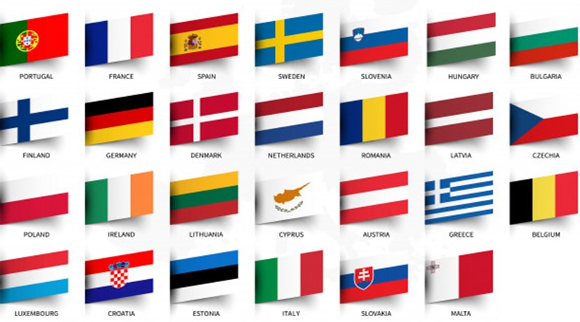
What is a multi-country (multi-regional) project?
A multi-country or multi-region project is a technical support project that is relevant or common to more than one Member State as it belongs to the same policy area and addresses the same priorities for technical support
#FamilyCentredECI

Slide 7
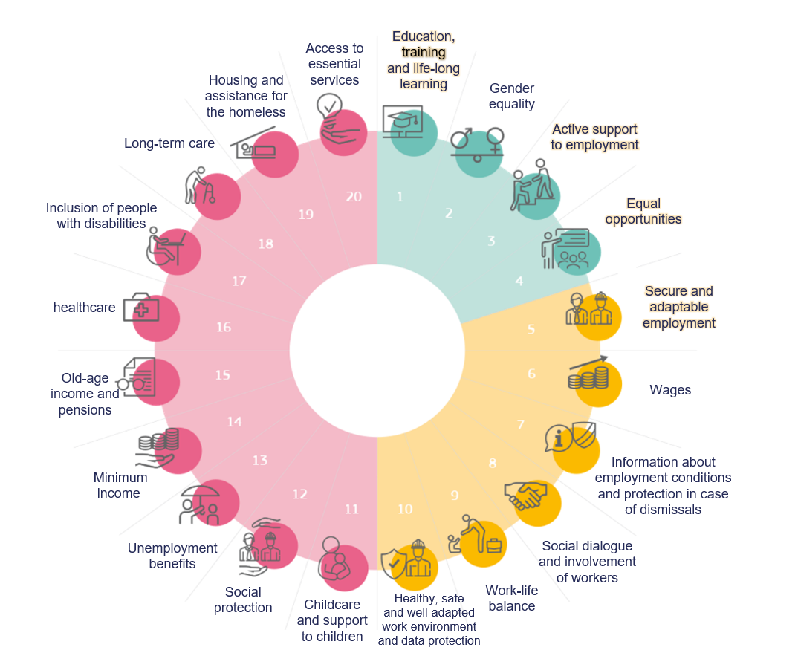
Policy Context @ EU level (1/2)
European Pillar of Social Rights:
Early childhood education & care
Inclusion of persons with disabilities
Long term care
15 million fewer people at risk of poverty or social exclusion by 2030, including 5 million less children
#FamilyCentredECI

Slide 8
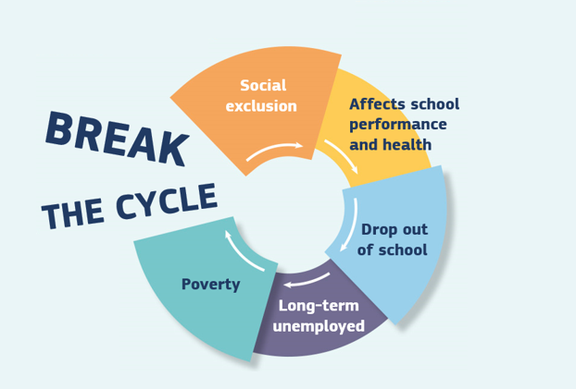
Policy Context @ EU level (2/2)
Council Recommendation establishing
a European Child Guarantee
European Strategy for the Rights of Persons with Disabilities 2021-2030
Independent living
#FamilyCentredECI

Slide 9
What broad types of technical support for ECI ?
Review and development of legislative and policy frameworks
Assessment of the state of play on access to key benefits and services
Capacity-building activities (e.g. trainings)
Stimulating stakeholder engagement
Design & implementation of specific services and policy measures/ national or regional strategies
Design of monitoring and evaluation mechanisms and tools
Pilot Testing of recommendations
#FamilyCentredECI

Slide 10
EU funding – TSI in combination with other sources
#FamilyCentredECI

Slide 11
Adoption of the requests – timeline
Preliminary communication of results to Member States
Analysis of requests by the Commission
Projects on the ground (from April 2024)
Oct 2023
Nov
Dec
Jan 2024
Feb
Mar
Apr
Deadline for submission of requests – TSI 2024 call (31 October)
Formal decision of the Commission
#FamilyCentredECI

Slide 12
Thank you!
European Commission
Directorate General for Structural Reform Support (DG REFORM)
Unit B4 – Labour Market, Education, Health & Social Services
https://ec.europa.eu/reform-support/index_en
Theodora.Giouroukou@ec.europa.eu
#FamilyCentredECI

