Slide 1
Workshop 8: Person-centred planning: what is it and how to get there?
Maarit Aalto
Educator
M.A.Education & Survey
Member of EASPD European Expert Network Light House
www.maeducation.fi
maarit.aalto@maeducation.fi
#QualitySocialServices

Slide 2
Workshop 8: Person-centred planning: what is it and how to get there?
Personal wellbeing
Personal
wellbeing
Personal wellbeing
Personal wellbeing
TO BELONG- TO FOCUS ON LIFE QUALITY
TO BE INDEPENDENT – TO FOCUS ON PERSONAL LIFE
TO PARTICIPATE –TO FOCUS ON ACCEPTANCE AND BE A PART OF THE OWN MATTERS
THE PERSON WITH DISABILITY
IN THE CENTER
Personal wellbeing
Personal wellbeing
TO BE COMPETENT- FOCUS ON CAPACITIES
Personal wellbeing
BE VALUED – TO FOCUS ON RESPECT AND EQUALITY
Personal wellbeing
TO CONTRIBUTE – FOCUS ON POSSIBILITIES AND GIVE TIME AND SPACE FOR THE PERSON
TO BE IN PLACES WERE EVERYBODY ELSE ARE – TO FOCUS ON INCLUSION
#QualitySocialServices

Slide 3
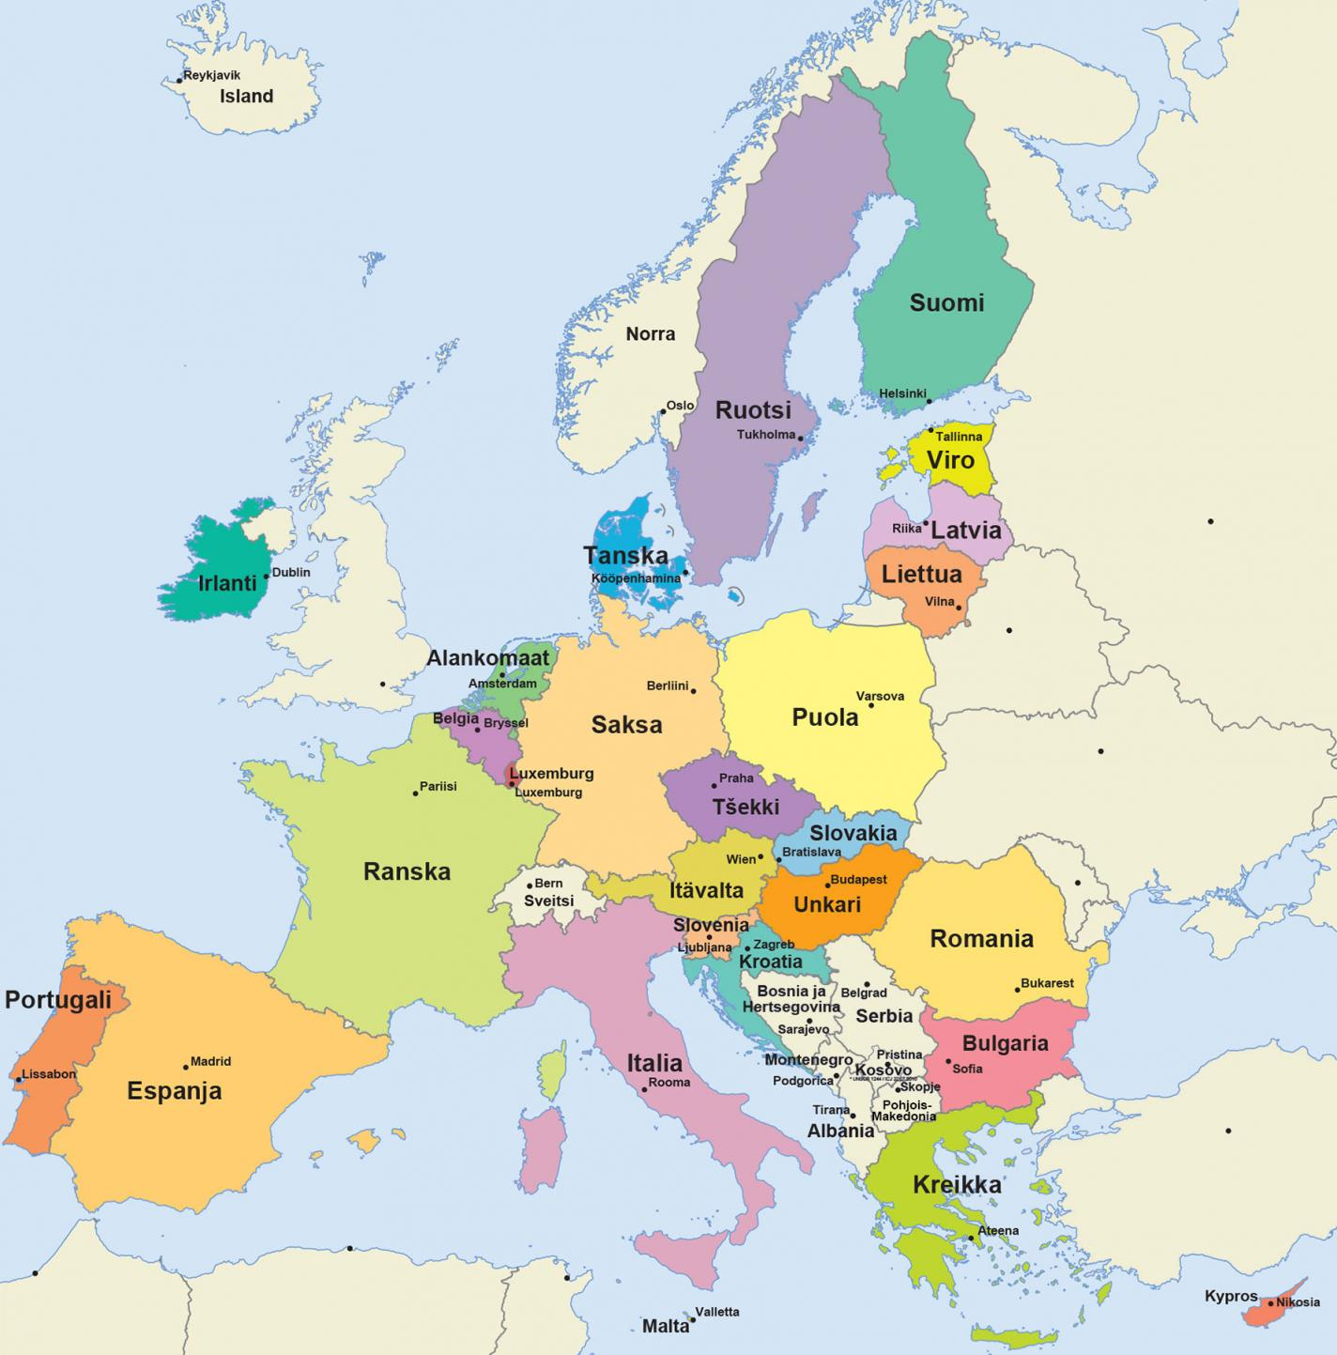
Introduction- first context
WE KNOW!
European strategy for the rights of persons with disabilities 2021-2030
PCP/PCA
National disability policy- strategies
Regional and local documents etc.
The goals to improve are:
Implementation of UNCRPD
Full inclusion and participation
Independent living
Non – discrimination
Equal opportunities
Deinstitutionalisation
Create Community based services
Remove obstacles etc.
#QualitySocialServices

Slide 4
Introduction – Second context
WE ALSO KNOW!
Reports from:
FRA=European Union Agency for Fundamental Rights for promoting and protecting human rights in the EU
PCP/PCA???
ANED Academic Network of European Disability Experts
Discrimination
Segregation
Unfair treatment
The rights are not fulfilled
Obstacles still existing for personal decision making or to make own choices
Etc. etc…. Concerning persons with disabilities
ENIL European Network on Independent living
And many other reports and researches tells us about ….
#QualitySocialServices

Slide 5
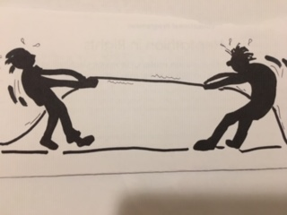
Introduction – third context
Confusion and tension is going on, in the daily life of the person with disability!.. In the services …
What is the consequences of our actions and support on the person with disabilities wellbeing?
#QualitySocialServices

Slide 6
Workshop 8: Person-centred planning: what is it and how to get there?
Personal wellbeing
Personal
wellbeing
Personal wellbeing
Personal wellbeing
TO BELONG- TO FOCUS ON QUALITY of LIFE
TO BE INDEPENDENT – TO FOCUS ON PERSONAL VIEWS
TO PARTICIPATE –TO FOCUS ON ACCEPTANCE AND BE A PART OF THE OWN MATTERS AND SOCIETY
THE PERSON WITH DISABILITY
IN THE CENTER
Personal wellbeing
Personal wellbeing
TO BE COMPETENT- FOCUS ON CAPACITIES
Personal wellbeing
BE VALUED – TO FOCUS ON RESPECT AND EQUALITY
Personal wellbeing
TO CONTRIBUTE – FOCUS ON POSSIBILITIES AND GIVE TIME AND SPACE FOR THE PERSON
TO BE IN PLACES WERE EVERYBODY ELSE ARE – TO FOCUS ON INCLUSION
#QualitySocialServices

Slide 7
How to get there? – in general
Person Centred planning PCP / Person Centred Approach PCA
It is all about a new understanding of persons with disabilities.
PWD is an active person with own personal views in all aspects in his/ hers life.
The goals to improve are:
Implementation of UNCRPD
Full inclusion and participation
Independent living
Non – discrimination
Equal opportunities
Deinstitutionalisation
Create Community based services
Remove obstacles etc.
It is about to develop a new professional profile and competence based on
PCP/PCA in connection to the Quality of Support and
implementation of UNCRPD
Better perception of the challenges and barriers in the intension to find solutions for PCP-processes.
#QualitySocialServices

Slide 8
How to get there?
Personal views
PCP/ PCA – always in cooperation with the person with disability
To implement the goals:
Implementation of UNCRPD
Full inclusion and participation
Independent living
Non – discrimination
Equal opportunities
Deinstitutionalisation
Create Community based services
Remove obstacles etc.
Cooperate and
Collect
information
2. Discover the current
wishes, needs and
rights
3. Find obstacles and
solutions
Implement agreements with the person
Ask, believe, collect, cooperate with the PwD, take seriously, use communication alternatives, etc.
Search knowledge about UNCRPD, read the articles in UNCRPD, learn to interpret rights to daily concepts/situations/ service quality, agree of personal priorities of rights etc.
Evaluate the current situation, remove obstacles and search for better support in the line with PCP, use support formulation…
#QualitySocialServices

Slide 9
To implement the renewed goals:
Implementation of UNCRPD
Full inclusion and participation
Independent living
Non – discrimination
Equal opportunities
Deinstitutionalisation
Create Community based services
Remove obstacles etc.
2. How to get there? – PCA is expanding
We need to create and be aware of the concrete processes towards PCP/PCA between the words and the daily life of the PWD, but also in service system and how to organise services. Fill the gap with actions.
We need to raise the importance of the quality of support and look into consequences
We need to improve the ability to interpret the goals to current daily personal life situations.
We need to expand the opportunities
Personal
System
level
Person in the centre
Organisa
tional
#QualitySocialServices

Slide 10
3. How to get there?... From words to action?
To Legitimate
Personal, system and organizational levels
To implement the renewed goals:
Implementation of UNCRPD
Full inclusion and participation
Independent living
Non – discrimination
Equal opportunities
Deinstitutionalisation
Create Community based services
Remove obstacles etc.
To legitimate
-to accept PCP/PCA in action
PCP/PCA Content: The person in the center
Quality of support
#QualitySocialServices

Slide 11
A summary: Concrete actions and tools to achieve PCA
The process of DI matters for everyone in the institutions – not only for some selected “groups of persons” ( ex. Also for persons with the severe intellectual disabilities, also for aging persons with disabilities”).
Make personal support plans based on personal rights, needs and wishes together with the person with disabilities
Assess the consequences of the given support for the person with disabilities (ex.
use THINA-Tool -Top House Individual Needs and Rights assessment), assess the
quality of support to personal needs, wishes and implementation of rights
Change and develop daily life situations based on personal experiences of the PWD, combined with the change of systems and service-structures. Every detailed action towards PCA matters to achieve a better personal wellbeing for the PWD.
Search for and recognise obstacles, which hinder the person centredness for example in the system level = rules, routines, decision making and information structures, time schedules, attitudes, mindsets and/or institutional culture based obstacles
PCP/PCA MATTERS!
To create only one direction
To implement the renewed goals:
Implementation of UNCRPD
Full inclusion and participation
Independent living
Non – discrimination
Equal opportunities
Deinstitutionalisation
Create Community based services
Remove obstacles etc.
#QualitySocialServices

Slide 12
Materials connected to PCP for Your use
THINA tool guide: THINA – Top House Individual Rights and Needs Assessment – a tool for professionals to develop and assess their quality of support concerning PwD:ies identity and implementation of rights./ Maarit Aalto
Fight for Rights – How to implement UNCRPD? – discussion guide out from concrete situations / Maarit Aalto and Riitta-Leena Karlsson
Success factors for Person Centred Planning/-Approach / Maarit Aalto
A statement about positive identity development of persons with disabilities as consequences of the support – a PCA-paper about support design / Maarit Aalto
Email address: Maarit.aalto@maeducation.fi
#QualitySocialServices

Slide 13
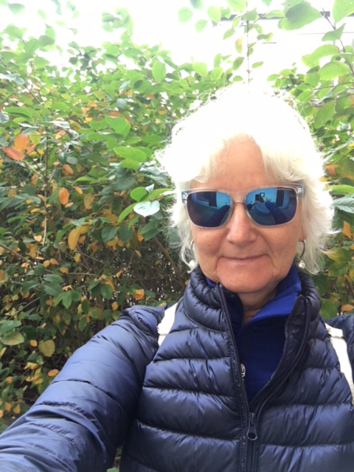
Thank You
and take care!
Maarit.aalto@maeducation.fi
www.maeducation.fi
M.A.Education&Survey
#QualitySocialServices

