Slide 1
Workshop 8: Training parents, the Denver Model and now and next
Moderator: Fabiana Scarano
Speakers: Eglantina Shllaku & Enron Seiti Annick Janson, PhD & Melissa Janson
#FamilyCentredECI

Slide 23
Can family participation
be a game changer?
Annick Janson, Clinical Psychologist, PhD
Melissa Janson, Psychologist, MA (Applied), PGDip
Plumtree Learning
#FamilyCentredECI
Notes:
2 minutes:
Intro:
Annick: xxxxx Today I speak as a mum first and a clinical psychologist second.
Melissa’s intro: … my experience with my brother inspired me to create a program that involves siblings… and the way to say hello in NZ is kia ora
Today we’d like to share with you what we’ve learnt in the past years, about working with families

Slide 24
Our questions today
Is there a need for change in the disability sector?
What change can we catalyse as service providers?
What change would YOU personally like to enable?
#FamilyCentredECI
Notes:
1 min - we’ll talk about these throughout the presentation

Slide 25
Main issues in ECI (1)
Definitions - no agreement
State of play - incomplete data
Legal framework and funding - lacking
Professional training and working conditions - poor
Workforce - shortages, stress
….. and?
#FamilyCentredECI
Notes:
1 minute: EASPD paper. It is becoming clear that current crises in our disability sectors cannot be solved by governments or professionals in isolation. Are there other players in the field that can help create change?
The Best Start in Life paper supports ECI - ie family participation, but none of the recognised challenges are about family role and no recommendations to train families - only train professionals
Game changer?

Slide 26
Main issues in ECI (2)
#FamilyCentredECI
Notes:
1 minute
If the lack of parent engagement is a major obstacle to your activity… perhaps there is another way to enrol parents!?

Slide 27
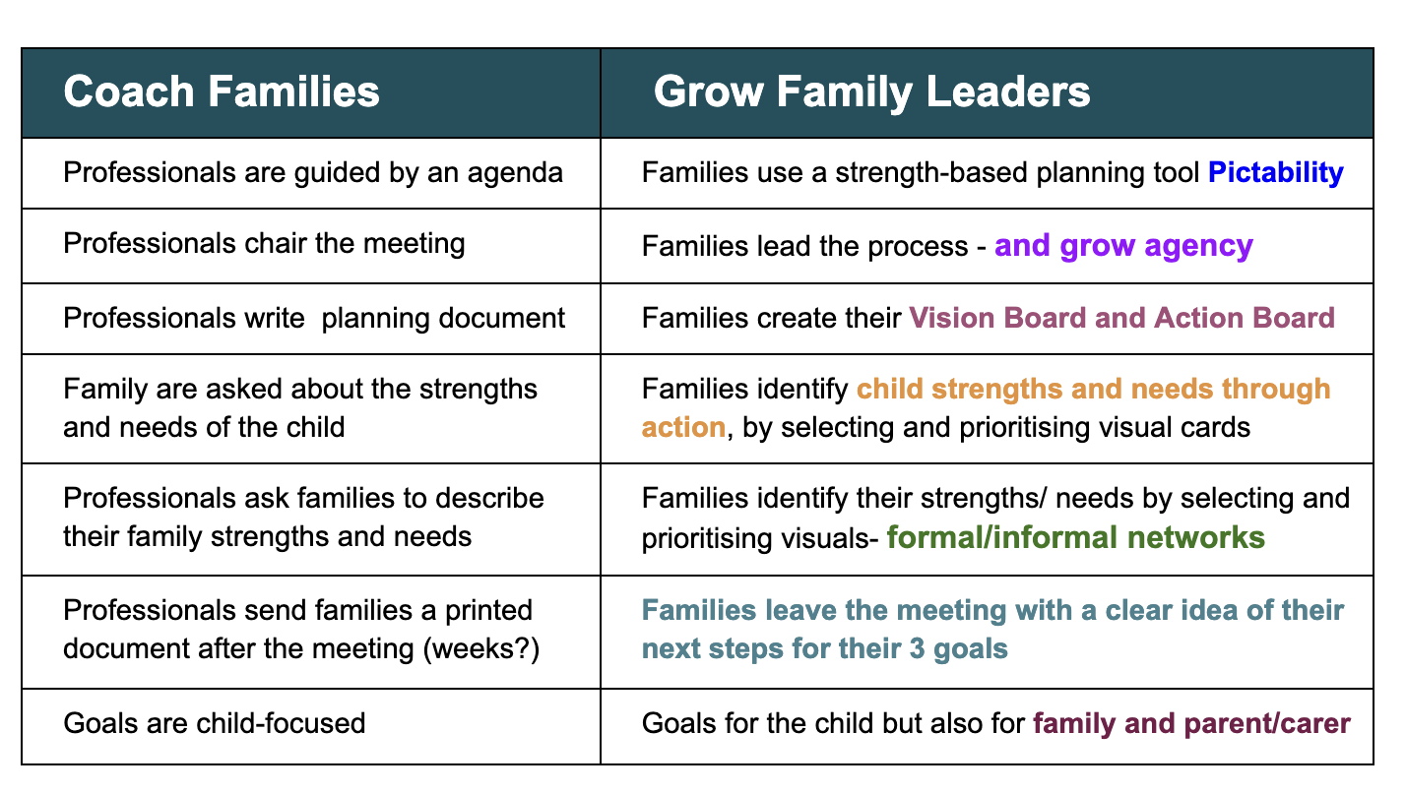
How do we engage families?
#FamilyCentredECI
Notes:
3 minutes
Melissa: Here is what I was doing in my previous job… we coached families: [Denver Model?]
Annick: Building family leadership - how does it start?What they’ll start to work on TODAY… [ Create an empowerment mindset right from the planning process start] Coaching is specific and focuses on the present. Leadership development uses the present to build skills for the future.
Not for presentation
Notes for Annick: The ESDM is an interdisciplinary approach to care for young children on the autism spectrum, characterized as a Naturalistic Developmental Behavioral Intervention. It shares commonalities with similar types of early interventions including delivery in natural contexts, shared control between the child and clinician, and use of behavioral principles/natural contingencies. REFERENCE Jill Howard & Geraldine Dawson Chapter 2020 in The Early Start Denver Model for Young Children with Autism: Promoting Language, Learning, and Engagement. Guilford Press, New York, 2010) is an evidence-based early intervention designed to promote developmental and social communication skills in young children with autism spectrum disorder between the ages of 12 and 60 months.

Slide 28
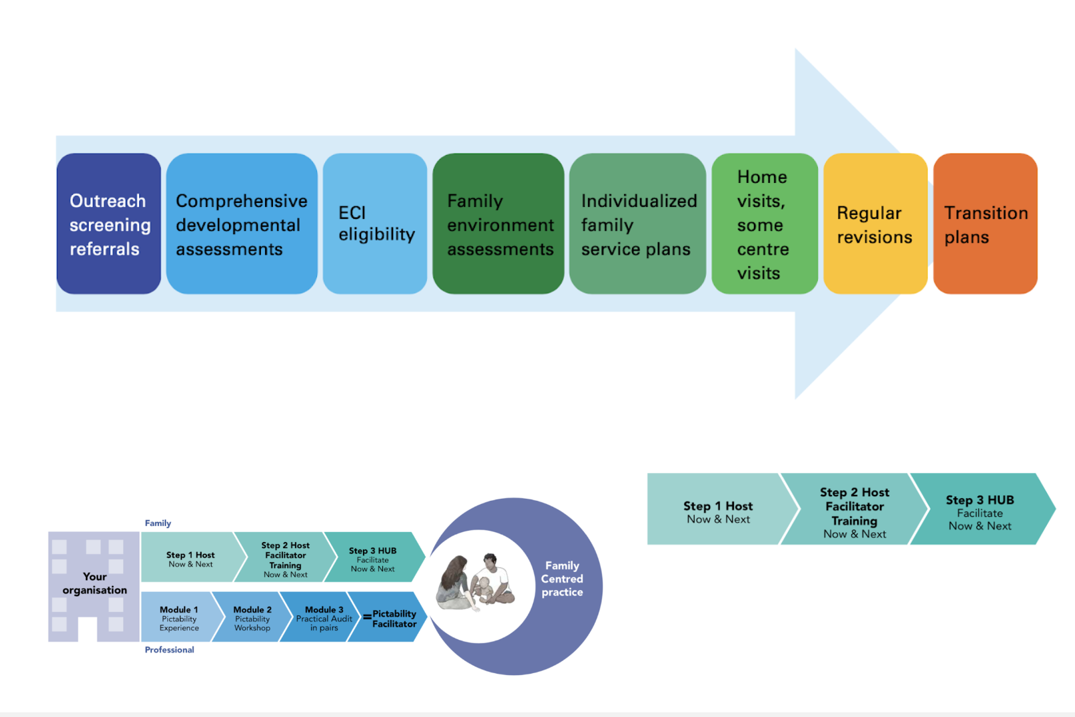
Models designed to create impact
Reference
#FamilyCentredECI
Notes:
1 minute [@4mins]
These intervention models obviously create different outcomes
A linear model focuses on the child’s outcomes
A family-centred models support families to create child outcomes AND build family capacity - i.e. create change in their community

Slide 29
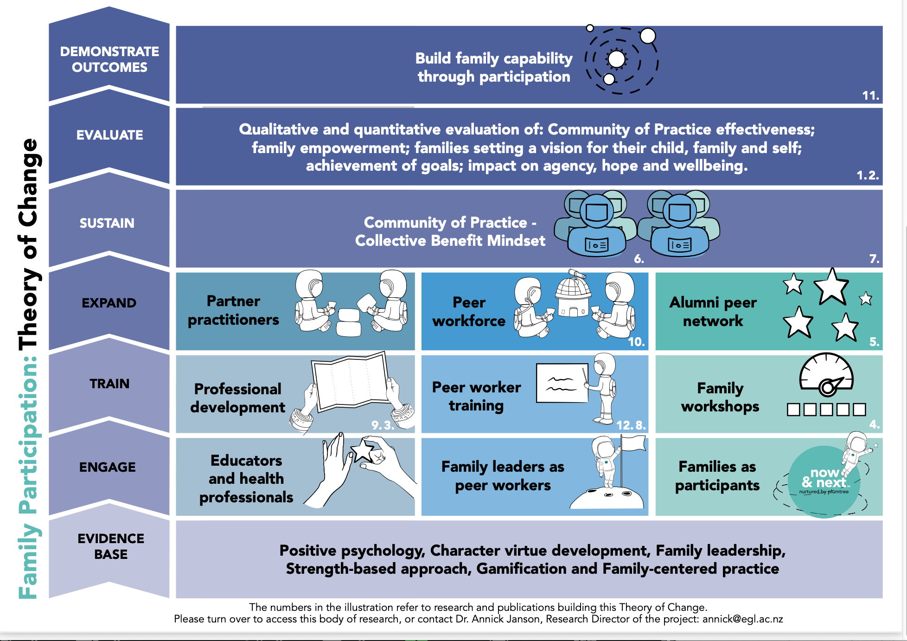
Our Theory of Change
Reference
#FamilyCentredECI
Notes:
4 mins [@6mins]
Our Theory of Change shows how we work with 3 different to create family participation, and ultimately sector outcomes

Slide 30
Paradigm questions
Who formulates the program goals?
Who reports to who?
Does the program include family goals and carers personal goals?
Who coaches the parents?
In what way is the program ‘strength-based’?
Who holds the pen?
Professional-led programs: done to/with the family.
Family-driven programs: done by the family.
#FamilyCentredECI
Notes:
2 minutes [@7mins]
Melissa: read the questions

Slide 31
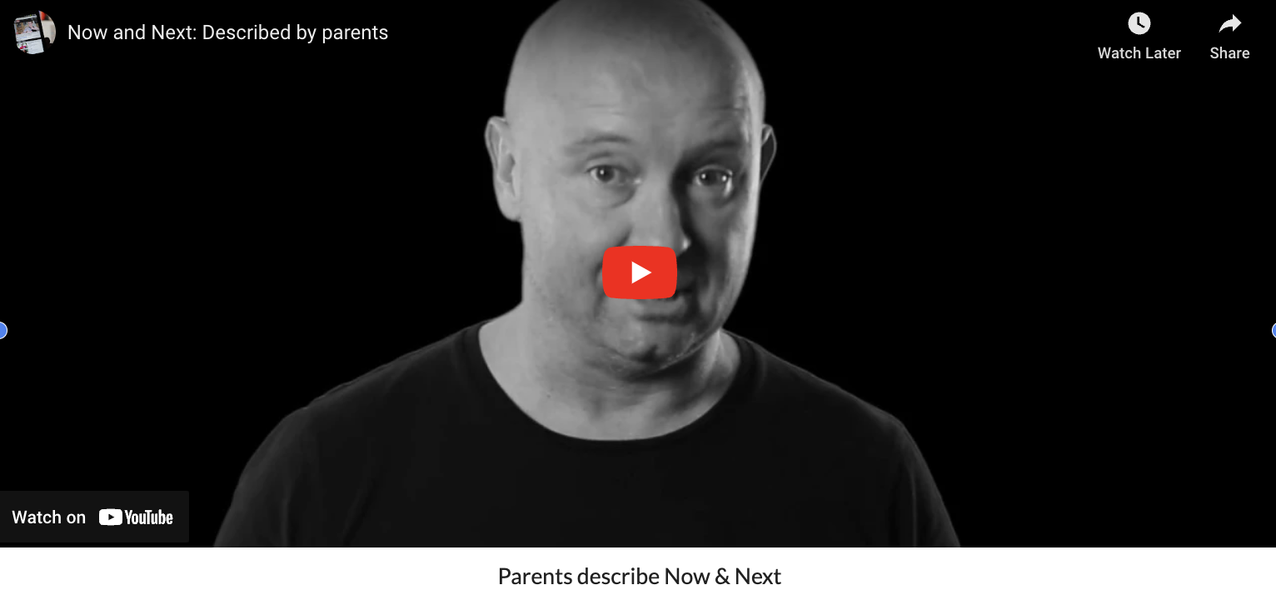
The Now and Next program
#FamilyCentredECI
Notes:
4 minutes [show only if we’re ealy] [@10mins]

Slide 32
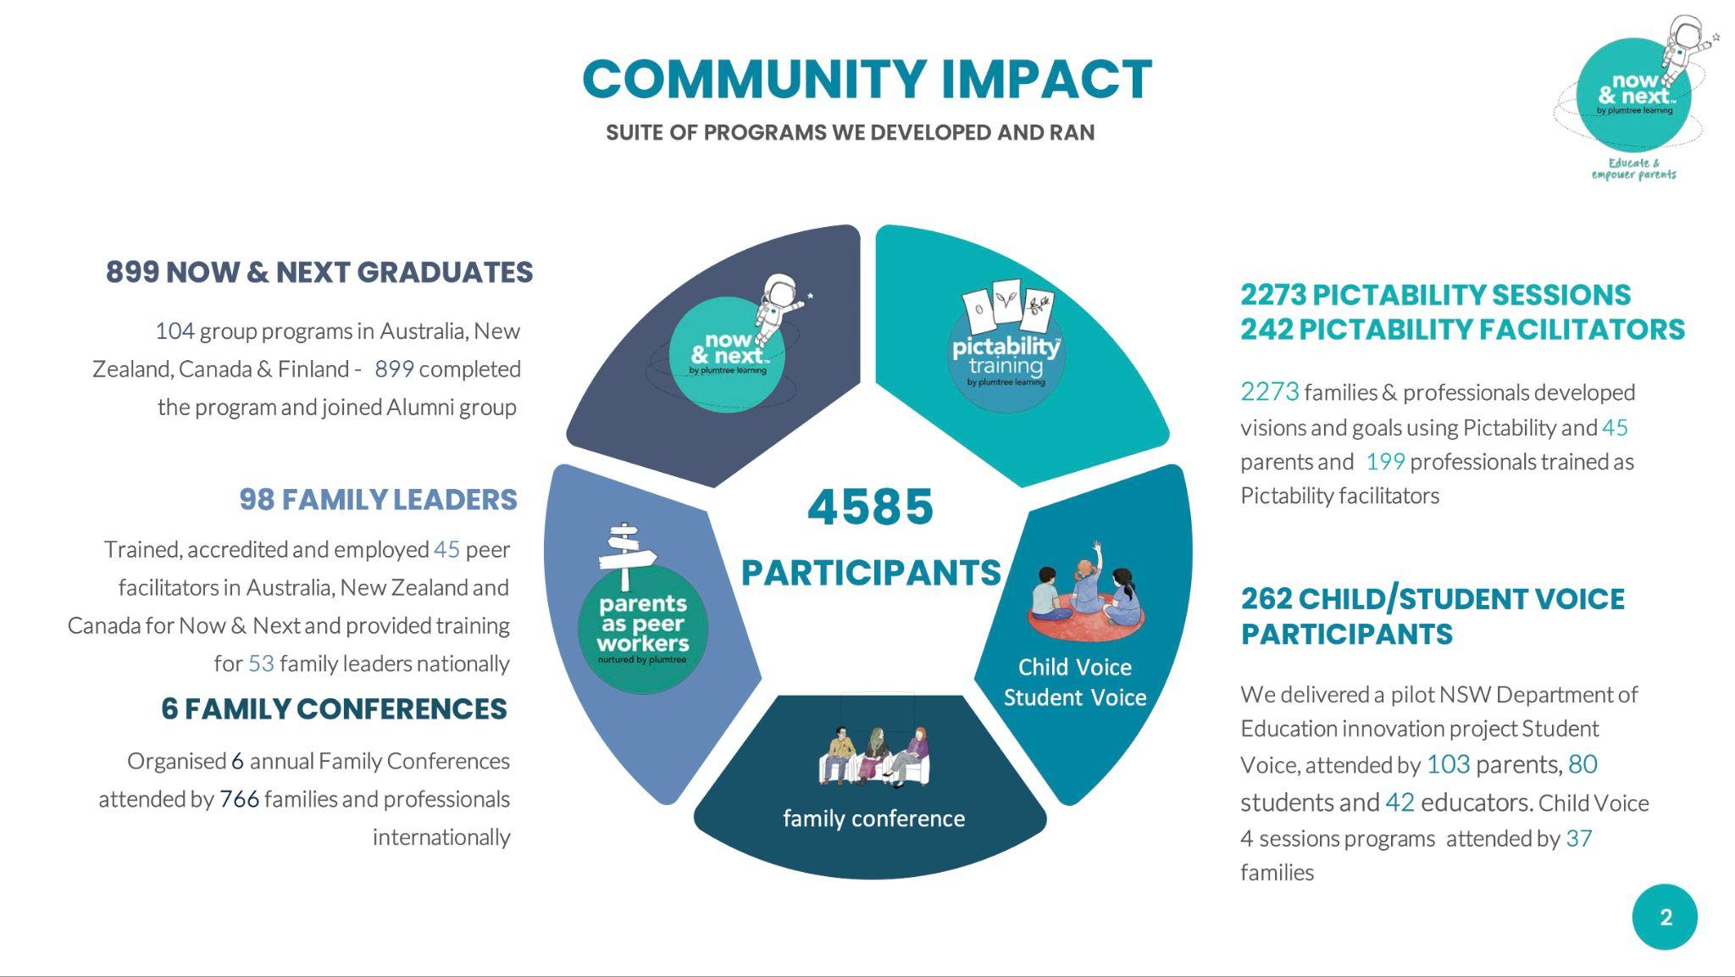
Program impact
REPORT
#FamilyCentredECI
Notes:
2 minutes
A 7 university consortium runs a comprehensive research program to report on the impact of the programs on families' empowerment, hope, agency, goal achievement and well-being.
Quantitative and qualitative data analyses describe how families organise into peer support groups which feed a leadership pipeline to generate system change.

Slide 33
Children
outcomes
#FamilyCentredECI
Notes:
1 minute
At a glance… parents report these outcomes for their children

Slide 34
This data shows that…
It is possible to:
build family capacity - empowerment data
improve family engagement - engagement data
grow emerging family leaders - leadership pipeline data
reduce professional burn out - professional feedback
#FamilyCentredECI
Notes:
1 minute
Annick

Slide 35
Testimony
I use ESDM and Now and Next as an intervention road map to support my daughter with Phelan-McDermid Syndrome. I choose goals from the curriculum checklist, then use the Goal to Action dashboard from Now and Next to outline how to achieve those goals. The models used together are empowering. Not only can I confidently identify what skills should be targeted, I can specify what I need/want from each member of her interdisciplinary team (teachers, physical therapist, and speech language therapist) to achieve them.
Anastasia. New Zealand
#FamilyCentredECI
Notes:
1min Melissa

Slide 36
Can family participation be a game changer?
Yes it can…
Build a leadership pipeline for family voice
Frontiers article
#FamilyCentredECI
Notes:
1 minute

Slide 37
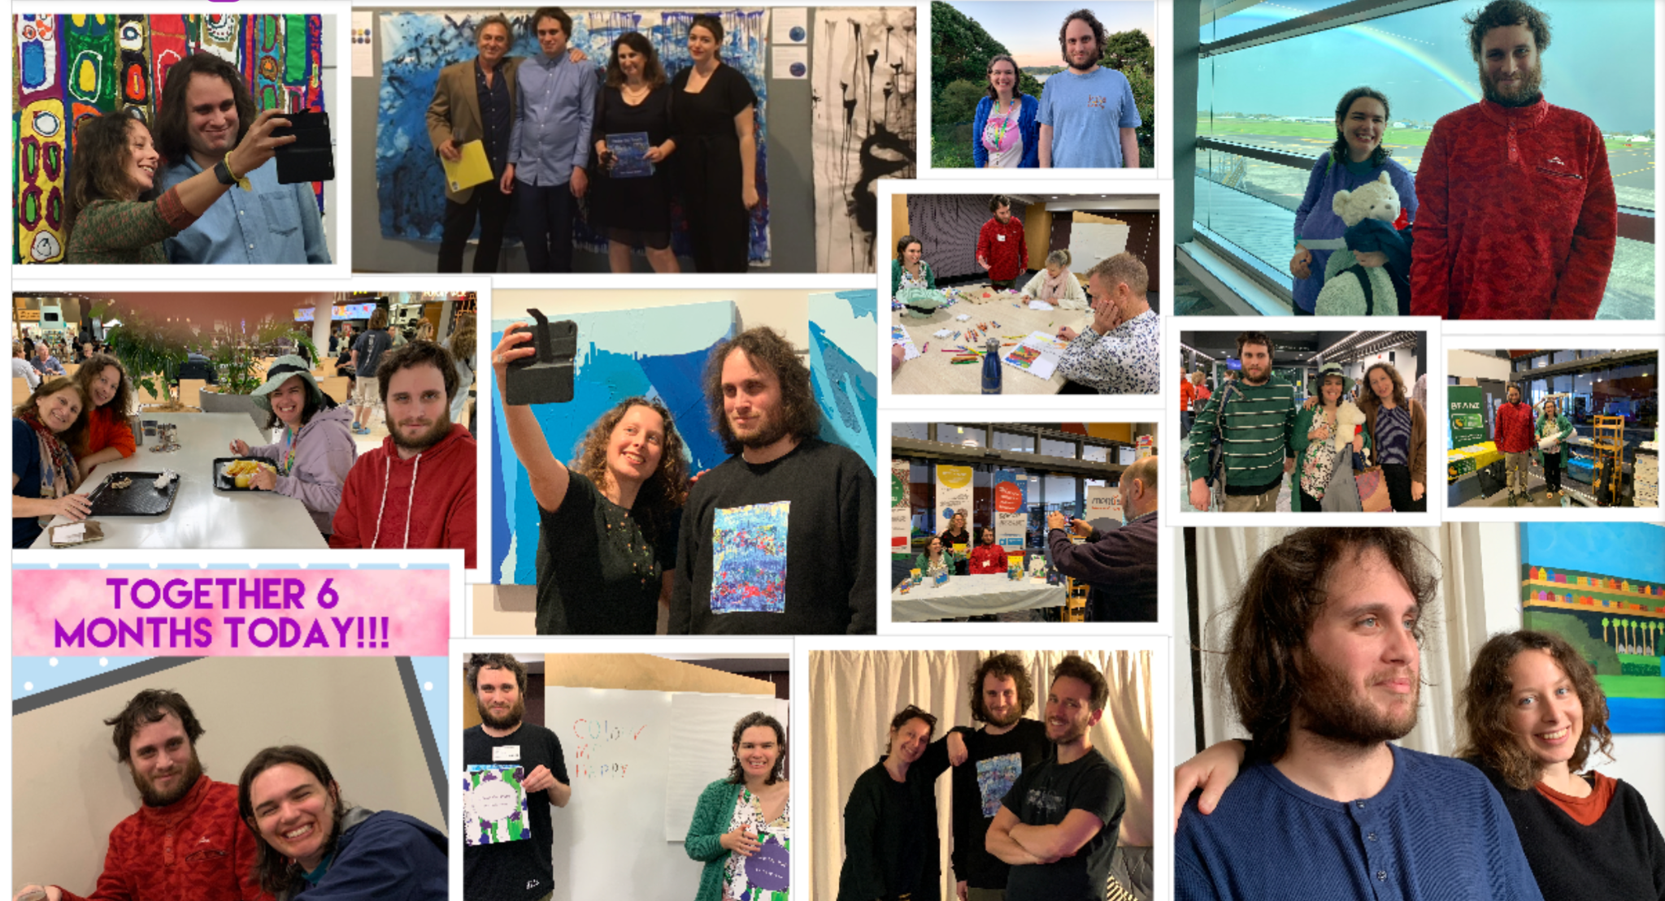

Slide 38
This presentation and additional materials are available on a website accessible as below:
Yes, family participation
can be a game changer!
Annick & Melissa Janson
Plumtree Learning
annick@plumtreelearning.com
melissa@plumtreelearning.com
https://tinyurl.com/easpd-families
#FamilyCentredECI
Notes:
End of presentation
I co-founded Plumtree Learning, an organisation run by parents raising children and youth with support needs whose mission is to build family capacity through participation.
Rooted in evidence: Systems-Informed Positive Psychology framework,
Now & Next is the first 'by families, for families' program of its kind to be offered worldwide.
In 2015, we launched a program co-designed and facilitated by families, for families.
Since our launch over 4500 families and professionals have participated in some of these programs which have evolved to become a cornerstone of the early childhood intervention (ECI) service delivery for providers located in Australia, New Zealand, and Canada.
What we learnt? That we were creating change beyond individual families into the disability sector. We were building a family leadership pipeline to drive change in the sector.
I aim to challenge disability sectors world-wide by identifying and activating the leverage points that can impact this sustainable change.

Slide 39
Note: The following slides will only be used if the audience asks for more information

Slide 40
Family-centered models
Reference
#FamilyCentredECI
Notes:
Family-centred models support families to create different outcomes.
https://www.unicef.org/eca/media/22066/file/Case%20study%204.pdf p.2 “ECI services should be based on family leadership, participation and needs in planning of services and provision of all or most of the services in the natural environment of the child as part of daily family routines”

Slide 41
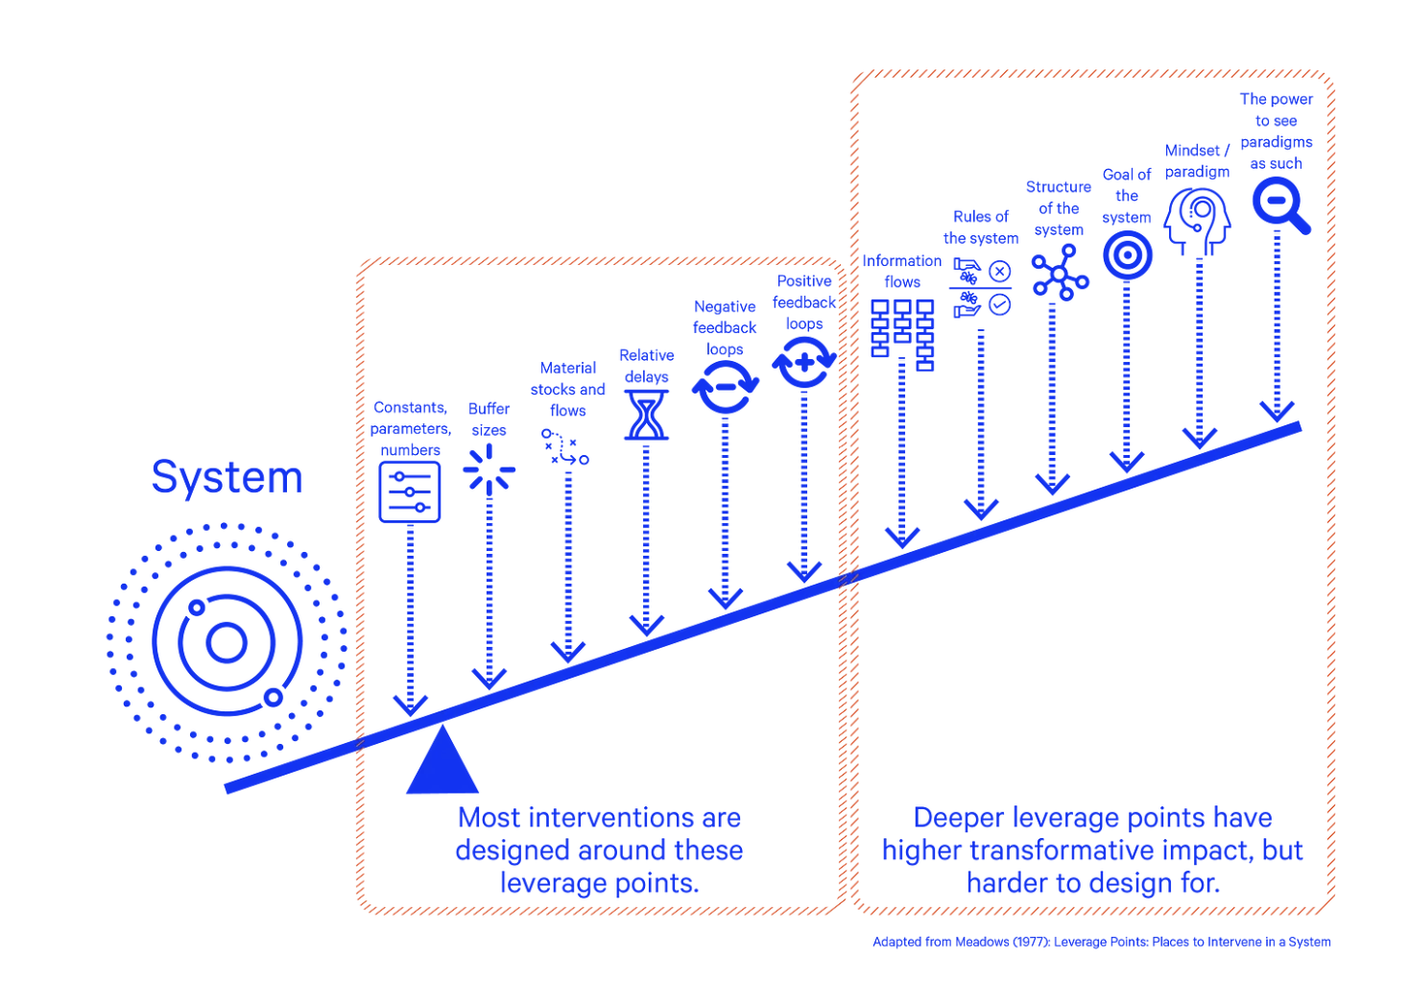
System change levers
Reference: Meadows (1999) Leverage points: Places to intervene in a system
#FamilyCentredECI
Notes:
Explain the system view of the levers of change
Building family leadership addresses one the most central paradigms of the disability sector - that parents can be core agents of change.
It is found at the top of the change levers classification!

Slide 43
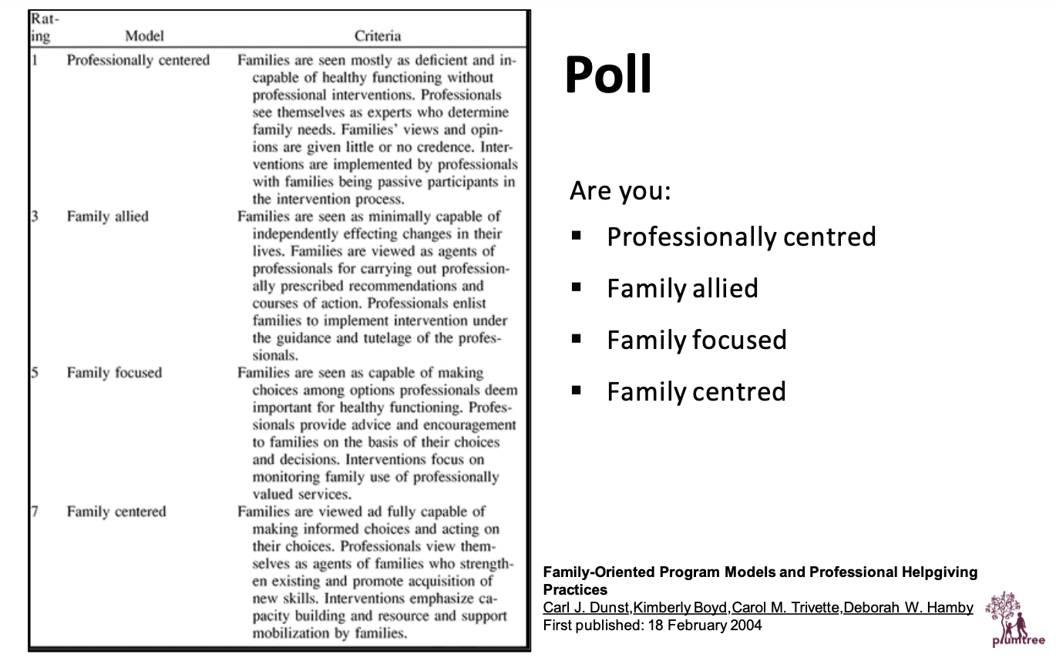
Family intervention models
#FamilyCentredECI
Notes:
5 minutes - Melissa
Family-centred is talked about everywhere… but are these models really tapping into the strengths of the families and mobilising them for sector change? … These models support families to create different outcomes.
Hohepa’s experience/asks the audience to relate to the poll
Our solution is to harness the yet untapped potential of families. As they build novel positive partnerships with professionals, they create unique outcomes for their children (based on the goals that they have formulated) and their families - as they grow their agency and expand their informal networks.

Slide 44
Family outcomes
Notes:
1 minute
At a glance, benefits reported by participants

Slide 46
11:00-11:30 COFFEE BREAK
HOTEL LOBBY
11:30-13:00 3rd panel - ECI in the context of emergency and displacement
AKERNIA
#FamilyCentredECI

