Slide 1








Workshop 1: ECI situation analysis and lessons learnt from UNICEF in North Macedonia and Montenegro
Moderator: Vera Rangelova, UNICEF ECARO
Speakers:
Aleksandra Karovska, Associate Professor, Institute of Special Education and Rehabilitation, Skopje
Ida Ferdinandi, UNICEF Montenegro
#FamilyCentredECI

Slide 2


NATIONAL SITUATION
ANALYSIS OF ECI IN NORTH MACEDONIA
Aleksandra Karovska Ristovska
#FamilyCentredECI

Slide 3

Jan-Apr 2022
Mar-May 2022
Apr-May 2022
Jun-Jul 2022
Focus groups for ECI staff and beneficiaries.
High level interviews
Desktop research and mapping
Questionnaires for ECI directors, staff and beneficiaries
Cost-benefit sub-study

Slide 4


Research objectives
Data for existing ECI services
Analysis of the current legislation
Analysis of the status and needs of children in rural and urban areas
Analysis of existing financing capacities
Identification of ECI staff and ECI training
Analysis of potential ECI programs and evidence-based recommendations
#FamilyCentredECI

Slide 5


ECI service coverage
Number of state centres
20
Number of ECI center in Skopje
55
35
33
Number of private centres
Number of ECI center in Macedonia
Number of ECI center in Macedonia
#FamilyCentredECI

Slide 6

ECI service coverage
NGOs
State centres
14 (34%) are private companies
16 (39%) are NGOs
44 ECI directors participated
11 (27%) are public health institutions
Number of ECI center in Macedonia
Private companies
#FamilyCentredECI

Slide 7
Eligibility for ECI services
(10-15% of children from birth to six have developmental delays)
140 436
10 175 (58%)
7 379
Number of children from birth to six (census 2021)
Number of children that receive ECI services
Number of children in need of additional ECI services
Number of ECI center in Macedonia
#FamilyCentredECI

Slide 8
Populations receiving ECI services
Age of children that receive ECI services
Delays/Disabilities in children that receive ECI services
Average age for onset of ECI services
25-36 months (36%)
Birth - 3 years
44%
42% - children with developmental delays
17% - children born at-risk
17% - children with behavioural and emotional difficulties
15% - children with disabilities
5% - children with mental health issues
5% - children with two or more disabilities/delays
- 31% are older than three years;
- 19% are at the age of 13-24 months;
- 7% are at the age of 7-12 months;
- 6% are at the age of 1-6 months.
31% are children from 5-6 years;
24% are children from 3-5 years.
Number of ECI center in Macedonia
#FamilyCentredECI

Slide 9
Populations receiving ECI services
64%
Average income
83%
Urban areas
80%
Macedonians
17% - children from rural areas that receive ECI services
13% Albanian ethnicity;
3% Roma;
4 % others.
20% - high income families;
15% - low income families.
Number of ECI center in Macedonia
#FamilyCentredECI

Slide 10
Location for provision of ECI services
Transitions towards a contemporary ECI programs.
81%
19%
0%
34 provide services only in the centre/hospital
8 centres provide services in the centre with occasional home visits
There is no ECI centre that is completely family-oriented
Number of ECI center in Macedonia
#FamilyCentredECI

Slide 11



Types of ECI services
1 centre (opened by UNICEF provides contemporary ECI services)
11% of the centres provide only ECI services
Child-centred services, lack of IFSPs, lack of parent education, lack of transition plans point to the low use of contemporary ECI services.
Number of ECI center in Macedonia
#FamilyCentredECI

Slide 12



Recommendations and eligibility
Recommendations
29% - parents
22% - children centres
19% - hospitals
Eligibility
8 centres ask for a medical diagnosis;
12 ask for a medical diagnosis and do a comprehensive developmental assessment;
23 centres ask for a diagnosis, do a comprehensive assessment or an at-risk status.
  The contemporary ECI programs determine eligibility within the ECI centres.
Number of ECI center in Macedonia
#FamilyCentredECI

Slide 13



Screening - Assessment - Teams
39% of parents participated in the screenings; 56% of the centres use screening instruments; 22% of the centres use ASQ III
76% parents received developmental assessments. None of the parents signed an IFSP.
64% - interdisciplinary teams;
30% - multidisciplinary teams;
6% - transdisciplinary teams.
Number of ECI center in Macedonia
#FamilyCentredECI

Slide 14






Staff, professional development and quality assurance
30% of staff satisfy standards for licensing
19% go through filed weekly
- 41% of centres are supervised
University degree - Unis in Skopje and Tetovo
Staff
Professional development
Quality assurance
Salary scales and certificates
2
4
6
1
3
5
Education
Supervision
90% of centres do not hire paraprofessionals
34% are speech therapists
32% are spec ed
14% are not trained in-service
Most desired training are professionals workshops and one-on-one trainings
No certified ECI program
49% of centres have salary scales
54% career ladders
Number of ECI center in Macedonia
#FamilyCentredECI

Slide 15




ECI programs, networking and inter-sectoral coordination
ECI programs
Monitoring
Inter-sectoral coordination
Networking
No external monitoring.
39% of centres have internal monitoring.
26% of centres work with clinical centres.
43% work with kindergartens and schools.
No official ECI procedures or standards.
No coalition or network of ECI providers.
Number of ECI center in Macedonia
#FamilyCentredECI

Slide 16

Cost-benefit analysis
01
93%
Parental fees
Monthly allowances
Ministry of Labor
02
03
Ministry of Health
Insurance fund
Resource centres
Ministry of Education
04
05
Municipalities
Program funds
Number of ECI center in Macedonia
#FamilyCentredECI

Slide 17

Recommendations
Number of ECI center in Macedonia
#FamilyCentredECI

Slide 18

Recommendations
Number of ECI center in Macedonia
#FamilyCentredECI

Slide 19



UNICEF NEXT STEPS
STEP 1
UN PROJECT - KEEP
STEP 2
Policy proposal
System services for ECI
STEP 3
Number of ECI center in Macedonia
Towards family-centred ECI
#FamilyCentredECI

Slide 20
Analysis for embedding services for ECI
PHASE 1
Policy development
Close collaboration with Ministries
Ongoing |
PHASE 2
ECI standards and procedures
Ongoing |
Two five-days trainings
PHASE 3
Capacity development
Mentor support for ECI professionals
Progress 100% |
PHASE 4
Monitoring and mentor support
To be implemented later |
Number of ECI center in Macedonia
#FamilyCentredECI

Slide 21

#FamilyCentredECI

Slide 22
Announcements
The Conference dinner will take place at 19h30 in the Plenary Room (Room Alkernia)
Member fora
Join us tomorrow for our 2nd day of the conference.
Starting time: 09h30
16h15-18h15 | Member Forum on Person-Centered Technology | Room: Bogdani
16h15-18h15 | Member Forum on Workforce Development | Room: Onufri
16h15-18h15 | Member Forum on Policy Impact Group | Room: Metropol
#FamilyCentredECI

Slide 23
Workshop 1: ECI situation analysis and lessons learnt from UNICEF in North Macedonia and Montenegro
Moderator: Vera Rangelova, UNICEF ECARO
Speakers:
Aleksandra Karovska, Associate Professor, Institute of Special Education and Rehabilitation, Skopje
Ida Ferdinandi, UNICEF Montenegro
#FamilyCentredECI

Slide 24

Theory of Change for ECI services
Pre-existing situations of children (fragile birth status, poverty, malnutrition, lack of stimulation, war)
Dimensions of a national ECI system (leadership, planning, coordination, financing)
Preconditions for providing quality ECI services (service standards, personnel, personnel development, etc.)
Core ECI services (identification, comprehensive assessment, IFSP, home visits, quality assurance, monitoring)
Key service outcomes (improvement in child development, quality of life and family competencies)
Generational benefits for the nation
Resulting child conditions (at risk situations, developmental delays, disability)
#FamilyCentredECI
Emily-Vargas Baron, 2022

Slide 25
Regional Realities related to ECI:
Legacy, Evolving, and Contemporary ECI Services
Continuum of Legacy, Evolving and Contemporary ECI Services
Attribute | Legacy Services | Evolving Services | Contemporary Services
Structural Framework
Type of model | Medical model | Evolving from Medical to Social Model | Social Model
Service approaches | Disciplinary and practice-based services | Moving toward interdisciplinary, evidence-based services | Interdisciplinary and evidence-based services
Legal basis | Medical policies and protocols | Considering the development of a Strategic Plan or Legislation | National ECI Strategic Plan and/or Legislation
Regulations | Medical protocols | Medical protocols plus beginning to develop national regulations | ECI Guidelines and Procedures
#FamilyCentredECI
Emily-Vargas Baron, 2022

Slide 26
Eci sitan Guiding Framework:
Contemporary ECI Programme Process
Developmental monitoring, screening, community outreach & referral
Comprehensive & approved developmental assessment
Establishment of ECI eligibility
Assessment of family interaction & environment, hygiene, diet, health, etc. Ecomapping & routine-based assessment.
Individualized Family Service Plan (IFSP)
Visits in the daily natural environment of the child’s home &/or inclusive childcare or pre-school setting.
Regularly scheduled reassessments of child & revisions of IFSP.
Transition Plan or program Completion Plan with parents & inclusive preschool.
#FamilyCentredECI
Emily-Vargas Baron, 2022

Slide 27

ECI SitAn - guiding principles
Developed as part of Mitigating the Impact of COVID19 on the Lives of Children and Families in Western Balkans and Tukey Action (EU-UNICEF 2021-2022), available at this link
Focus is on:
  Enabling policy environments
  Adequate coverage of eligible children
  Outreach with developmental screening
  Easy access to early childhood intervention (ECI) services
  Equity and quality
  Evidence-based contemporary services
  Accountability
#FamilyCentredECI
Emily-Vargas Baron, 2022

Slide 28
ECI SitAn Methodological Guide
Systemic Enquiry
Literature Review
ECI Service Provider Enquiry
Surveys
Focus Group Discussions
Beneficiary Enquiry
Survey
Focus Group Discussions
Cost & Finance Sub-Study
Cost & Finance Sub-Study of 5 to 6 Selected ECI Service Providers
Mapping Study
Interviews
#FamilyCentredECI
Emily-Vargas Baron, 2022

Slide 29



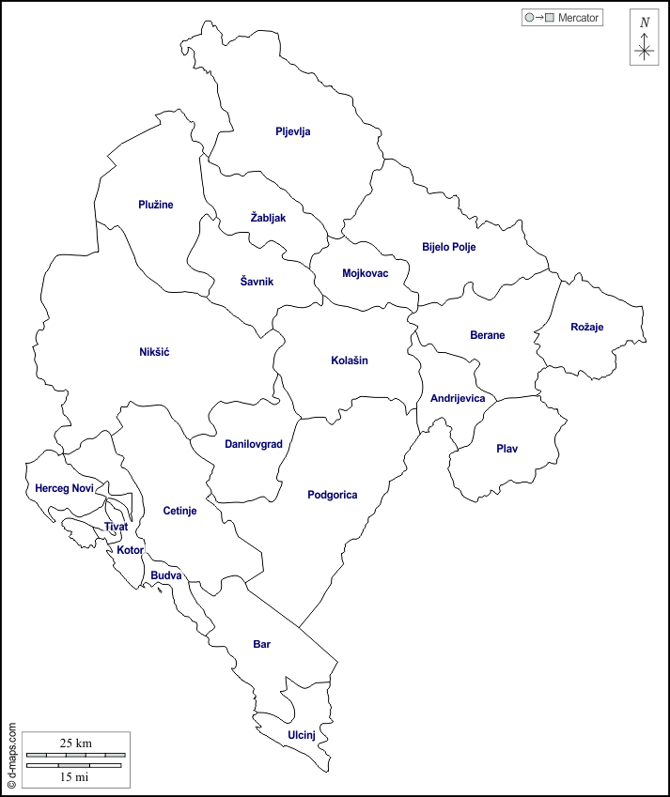
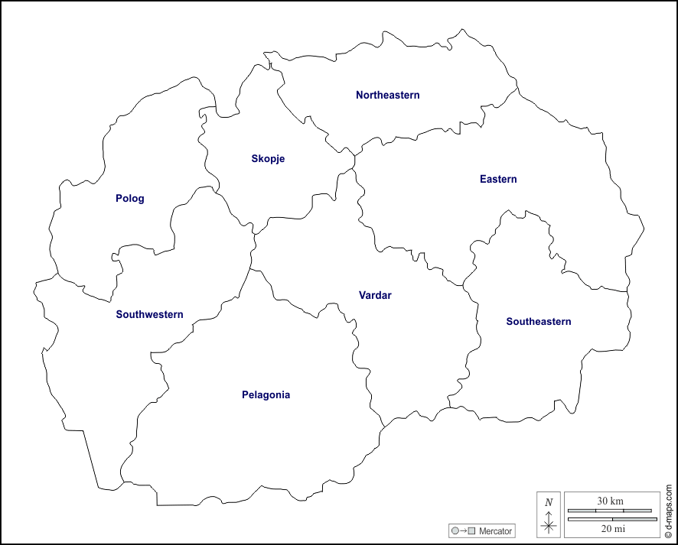
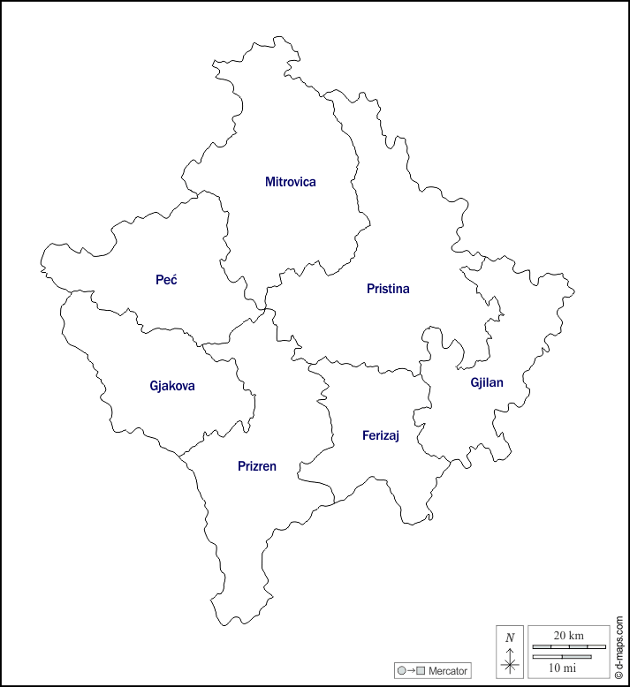
Field testing the methodological guide in
three locations
#FamilyCentredECI

Slide 30
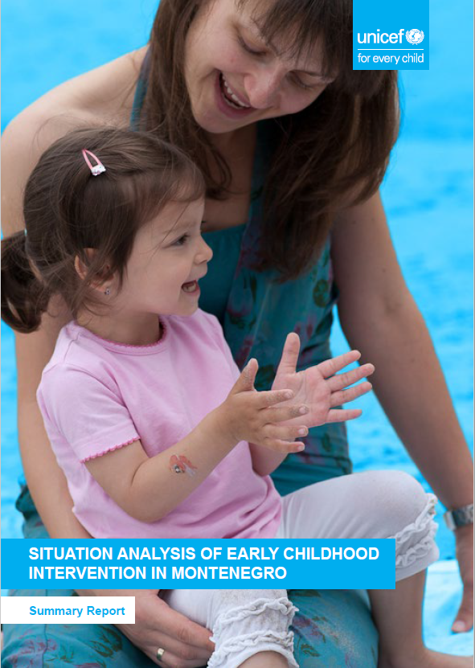


Field testing the methodological guide in
Montenegro
#FamilyCentredECI

Slide 31
Research team in Montenegro
Sonja Vasić, MD, Montenegro, ECI Specialist, Lead Field Researcher
Itana Kovacevic, MA, Montenegro, Psychologist and Social Researcher
Antonela Ciupe, PhD, ECI Specialist, Romania, Lead Author, Senior Fellow RISE Institute
Kristel Diehl, MA, MS, Colombia, ECI Research Analyst, Deputy Director, RISE Institute
Natalia Kakabadze, MA, Georgia, Economist and Researcher, Senior Fellow, RISE Institute
Emily Vargas-Barón, PhD, USA, Policy Planner and ECI Researcher, Director, RISE Institute
#FamilyCentredECI

Slide 32
Situation analysis in Montenegro – Overview of Services
Education
Three Resource Centres
Inclusive preschool institutions
Health
Centres or units for children with special needs in PHCs
NGOs
NGOs (including parents associations)
Social & Child Protection:
Day Care Centres,
Centres for Social Work
Hospitals at 2 and 3rd level including NICU
#FamilyCentredECI

Slide 33
Situation analysis in Montenegro – Building on Strengths
Most institutions studied are evolving to become contemporary ECI providers
All 3 public sectors fund services quite consistently, and want to identify ways to coordinate with other sectors
Service professionals uniformly expressed great interest in receiving training in contemporary ECI
#FamilyCentredECI

Slide 34
Situation analysis in Montenegro – Challenges
No ECI strategic plan, guidelines and procedures, and service standards
Fragmented ECI system, incl. budgetary
No universal screening system, late indentification
~ 10% to 15% children from 0 to 6 years require ECI services annually but less than half receive it
Substantial disparities, underserved communities
Quality issues (centre based, assessments, plans, caseloads, training, supervision, accountability)
Financing
#FamilyCentredECI

Slide 35
SitAn in Montenegro – Recommendations
Develop and ECI database for monitoring and evaluation for accountability
Plan and Conduct Campaigns for ECI Advocacy and Social Communications
Develop universal system for developmental monitoring/screening
Shift to equitable, family centered ECI services
Develop integrated Pre- and In-service ECI training programmes (vs. fragmented specialised) & pilot in demonstration sites
Establish integrated and multisectoral ECI coordination system, incl. budgetary
Develop ECI strategic plan, guidelines and procedures, and service standards
#FamilyCentredECI
Notes:
focused on types of disabilities – medical approach

Slide 36
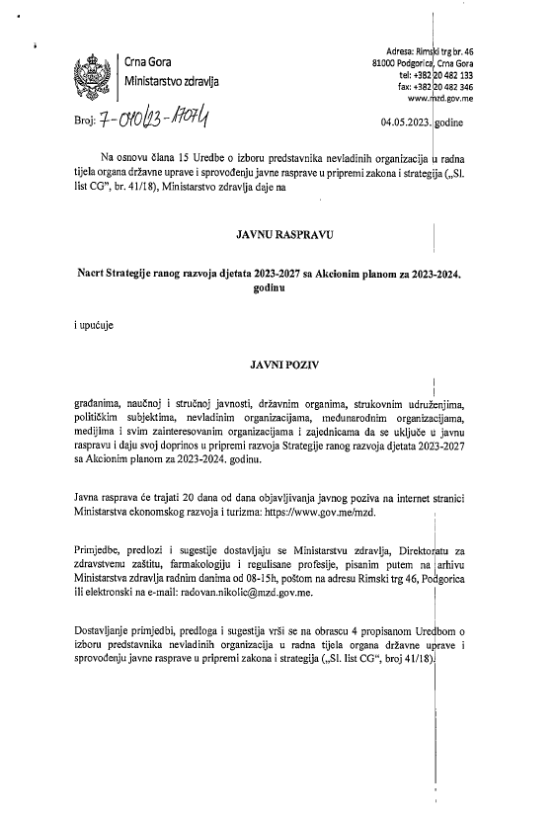
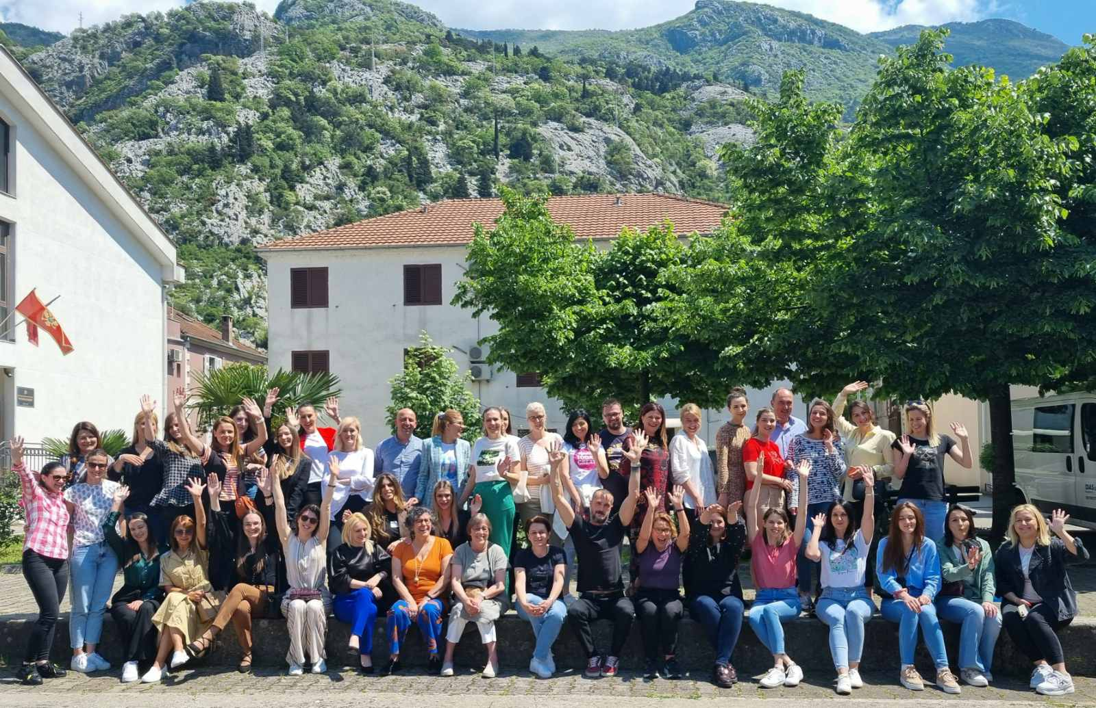
Going forward
First national ECD Strategy (2023-2027) under public discussion
Demonstration sites: Kotor and Bijelo Polje
  Child developmental monitoring/screening
  Routine-based, family-centered ECI
3. .
#FamilyCentredECI

Slide 37

THANK YOU iferdinandi@unicef.org
#FamilyCentredECI

