Slide 1
WORKSHOP:
Parental and ECI professional burnout:
Definition and strategies for preventing it
Moderator: Agapi Papadaki, Amimoni
Speakers:
Vicky Krokou, Amimoni
Nikos Papastamatiou, Omegatech
9th June 2023, Tirana
#FamilyCentredECI

Slide 2
Burnout of Professionals and Parents with Children with Disabilities:
Prevention, common challenges and mutually empowering methodologies and practices in Early Child Intervention Services
Vicky Krokou
#FamilyCentredECI

Slide 3
Activities
ACTIVITY 1: MENTIMETER
“Which profession has the highest burnout rate?’’
#FamilyCentredECI

Slide 4
U.S. Workers' Burnout Rates by Industry, 2022
% Always/very often
K-12 education | 44
College or university | 35
Professional services | 33
Government or public policy | 33
Retail | 32
Healthcare | 31
#FamilyCentredECI

Slide 5
Did you know?
67% of all workers believe burnout has worsened during the pandemic.
27% of all workers are unable to unplug from work.
(survey by Indeed)
Recent studies have highlighted that 65% of Professionals in the social care are emotionally disturbed.
(Social Services Workforce in Europe, FESE Report, 2019)
Female teachers in particular are especially burned out, at 55%, with male teachers following at 44%.
#FamilyCentredECI

Slide 6
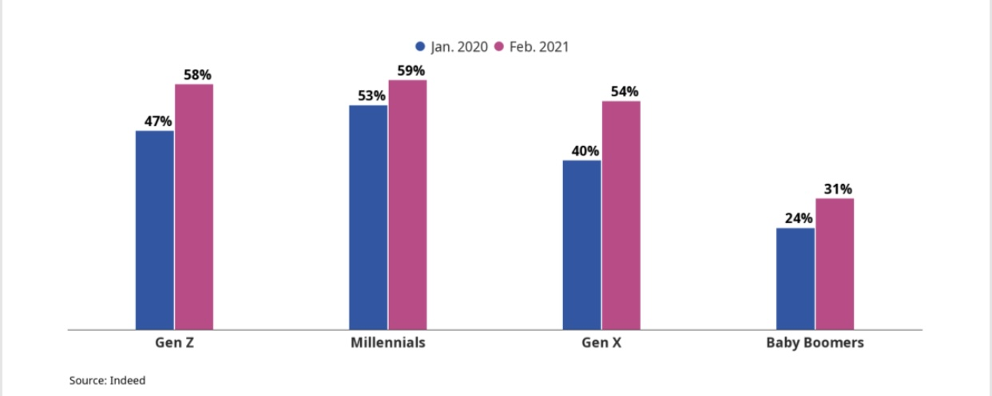
How feelings of burnout have changed during Covid-19
#FamilyCentredECI

Slide 7
Parental burnout
Studies have also highlighted the increased risk of burnout among parents caring for a child with a disability (Aktan, Orakcı, & Durnalı, 2020)
Study in 17,409 parents (12,364 mothers and 5,045 fathers)
from 42 countries around the world discovered that burnout varied drastically by country, based on the differences in Eastern and Western cultural values (Roskam et al., 2021).
The findings suggest that at least 5% of parents have burnout, while the percentage in some countries reaches 8% (Roskam et al., 2021).
#FamilyCentredECI
Notes:
The findings suggest that culture has a major impact on parental burnout and that parents from individualistic countries seem particularly exposed.

Slide 8
World Health Organization updated definition of burnout:
“Burnout is a syndrome conceptualized as resulting from chronic workplace stress that has not been successfully managed.
It is characterized by three dimensions:
1) feelings of energy depletion or exhaustion;
2) increased mental distance from one’s job, or feelings of negativism or cynicism related to one’s job;
3) reduced professional efficacy” (WHO, 2019)
#FamilyCentredECI

Slide 9
Parental Burnout
4 dimensions:
1. exhaustion in one's parental role,
2. contrast with the previous parental self,
3. feelings of being fed up with one's parental role
4. emotional distancing from one's children
(Roskam, Brianda, & Mikolajczak, 2018)
#FamilyCentredECI

Slide 10
Activities
ACTIVITY 2: MENTIMETER
“IDEAS ON HOW TO PREVENT PROFESSIONAL BURNOUT”
#FamilyCentredECI

Slide 11
Activities
ACTIVITY 3: MENTIMETER
“IDEAS ON HOW TO PREVENT PARENTAL BURNOUT”
#FamilyCentredECI

Slide 12
The Burnout FREE ECI Project
in a nutshell
#FamilyCentredECI

Slide 13
Partners
The Burnout Free ECI consortium consists of 1O Partners & 1 Associated Partner from 8 different countries.
In specific, the following partners compose the consortium of this project:
AMIMONI - Panhellenic Association of parents and friends of visually impaired people with additional handicaps / Coordinator - Greece
SVEUCILISTE U ZAGREBU / Croatia
UNIVERSITATEA BABES BOLYAI / Romania
UNIVERSITY OF THESSALY / Greece
EUROPEAN ASSOCIATION OF SERVICE PROVIDERS FOR PERSONS WITH DISABILITIES / Belgium
MALI DOM - Zagreb dnevni centar za rehabilitaciju djece i mladezi / Croatia
C.E.C.D. MIRA SINTRA - CENTRO DE EDUCACAO PARA O CIDADAO COM DEFICIENCIA CRL / Portugal
KARIN DOM Foundation / Bulgaria
THEOFANIS ALEXANDRIDIS KAI SIA EE (Omegatech) / Greece
KYPRIAKI ETAIREIA PISTOPOIISIS LIMITED (CCC) / Cyprus
Down Syndrome Albania Foundation “DSA” / Associated Partner-Albania
#FamilyCentredECI

Slide 14
The Burnout FREE ECI project addresses the tremendously serious issue of professionals’ and parents’ burnout on the family centered Early Child Intervention.
It aims to enhance the protective factors and reduce the burnout risk factors
for family and ECI professionals .
#FamilyCentredECI

Slide 15
To respond to Parents’ with children with disabilities and Professionals’ needs the project applies an Innovative Burnout Free approach in ECI services and attempts to :
foster positive connections,
develop the skills for effective parenting
Develop skills for effective professional role
improve self-awareness,
enhance their resilience,
improve their well-being and
engage in social life
Provide access to meaningful learning
for self-empowerment and
for effectively supporting children with disabilities
#FamilyCentredECI

Slide 16
The project will also address the Organizations’ needs and attempts to:
build connected and dedicated teams
create a positive culture of resilience
detect the risk factors for burnout
apply effective leadership approaches
increase the quality of services offered
#FamilyCentredECI

Slide 17
The ultimate aim of the project is to meet the needs of children with disabilities in order to have better quality of care and support, maximizing their strengths and potentials
#FamilyCentredECI

Slide 18
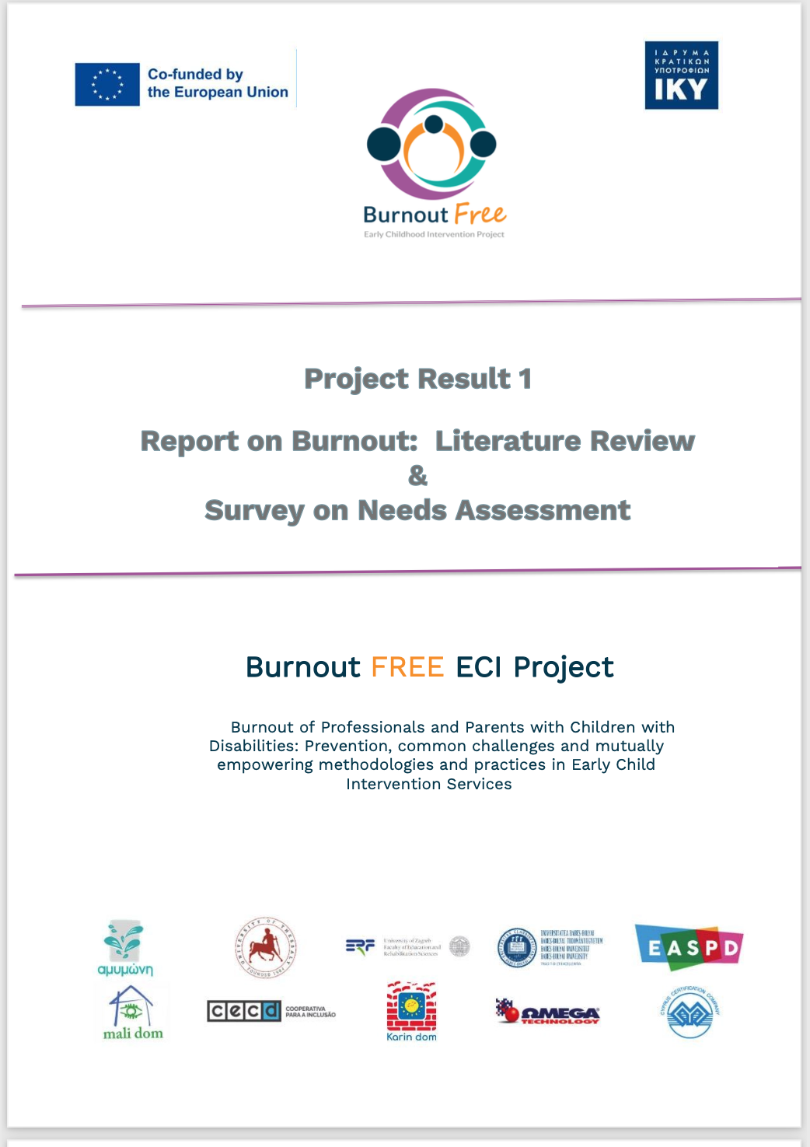
Throughout its three-year duration, the ‘Burnout FREE ECI Project aims to develop 6 project results:
PR1
All you need to know
on Burnout:
An overview of Literature and scientific research on burnout in European countries and beyond
Α survey on needs of more than 284 parents and 227 professionals in more than 8 European countries regarding burnout prevention
#FamilyCentredECI

Slide 19
PR2
Burnout Free ECI Training Material for Professionals and Parents
This Training material consists of:
1. Trainer’s manual
2. Workbook for Professionals
3. Workbook for Parents
User friendly and easy to follow Training material on Burnout Free practices for professionals and parents with children with disabilities participating in Early Intervention programs (ECI)
#FamilyCentredECI

Slide 20
PR3
Pilot implementation of Burnout Free ECI Techniques
Design of Pilot
Webinar
Pilot implementation phase
Data analysis and creation of the Burnout Free ECI Pilot Report
Methodology guide and tools for applying burnout free practices in Early Intervention programs and respective report after a pilot implementation from ECI service providers
#FamilyCentredECI

Slide 21
PR4
E-Learning game
Game for professionals and parents with examples of everyday life challenging situations and easy-to-use practices for burnout prevention.
Freely available for IOs and Android devices
Burnout Free E-learning game for parents and professionals, simulating interactive daily stressful situations, and suggesting easy-to-use practices for increased self-awareness, and professional & personal well-being.
#FamilyCentredECI

Slide 22
PR5
Certified knowledge
I. Certification of the Train the Trainers Course
II. Certification of Professionals
Certified Burnout FREE Train the Trainers program for ECI professionals leading to in-depth knowledge of practices for burnout free prevention and enhanced certified professional skills.
#FamilyCentredECI

Slide 23
PR6
Digital toolkit and replication methodology
I. A Digital Toolkit
II. Replication strategy for disseminating knowledge on
Burnout prevention techniques
Creation of a Digital toolkit with burnout free material, freely accessible to an engaged and empowered community of professionals and parents with children with disabilities.
#FamilyCentredECI

Slide 24
Activity 4: one page profile
One page profile
A Person-Centred Planning tool
a single page
important information about a person
what is important to them,
what people appreciate about them, and
how they want to be supported
Activity: in what cases can this tool be applied?
Be creative!!!
#FamilyCentredECI

Slide 25
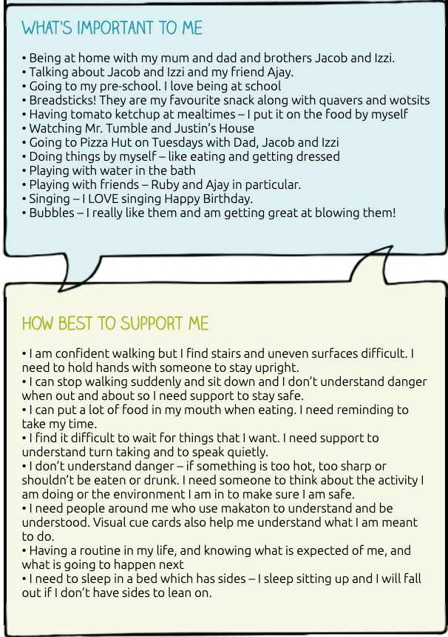
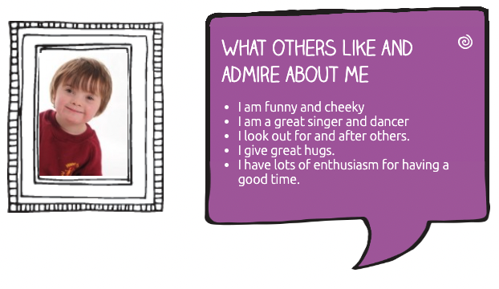
One page profile
This is a one-page profile created by Alex’s mother.
Take a few moments to think how this profile can be used in order to make the child with disability visible to others?
To whom can this be addressed?
By whom can this be completed?
How can this be useful?
What are the major benefits of creating such a profile?
#FamilyCentredECI
http://helensandersonassociates.co.uk/person-centred-practice/one-page-profiles/one-page-profile-social-care/learning-disabilities-one-page-profile/

Slide 26
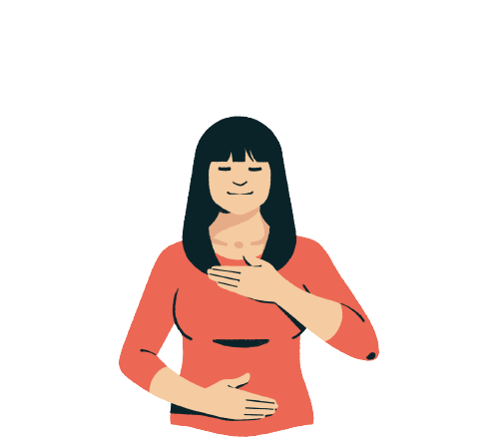
Mindfulness
(35) 2 Minute Re-Centering Mindfulness Meditation for De-stressing - YouTube
#FamilyCentredECI

Slide 27
Find us at:
Facebook
https://www.facebook.com/burnoutfree
Instagram https://www.instagram.com/burnoutfreeproject/
LinkedIn Burnout FREE Project | LinkedIn
Website
https://www.burnoutfree.eu/
#FamilyCentredECI

