Slide 1
Dutch ECI model
Marit Recourt-Vollebregt
#FamilyCentredECI

Slide 2
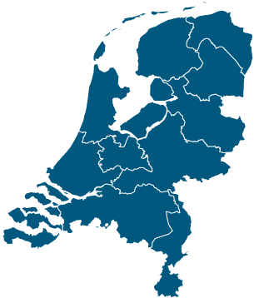
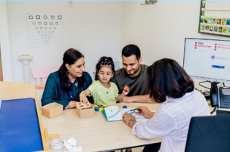
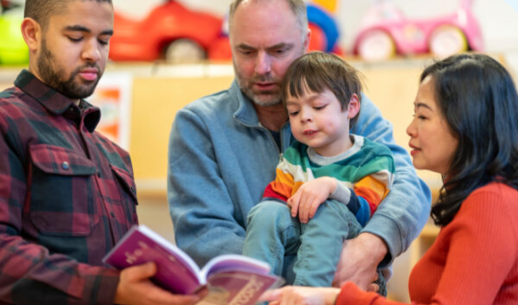
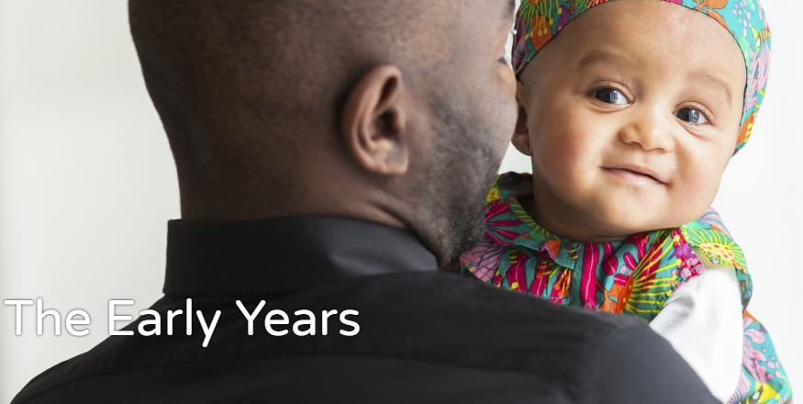
Youth healtcare for all children -9months till 18 years
Youth help if indicated
NGO’s to connect and support
#FamilyCentredECI
Notes:
Size: 41,850 km
Population: 17 million
Birth rate 170.000
Children with disabilities 100.000
Youth health care, payed by the goverment, free for all children, (birth registration) attendance 99,2%, performed by doctors and nurses, since 1900
Youth help, payed by the municipality, if indicated, 0-4years about 30.000, 3300 with recidence, since 1970
Both are given in local area

Slide 3
Title
Paragraph
#FamilyCentredECI

