Slide 1
Family centered ECI as
holistic family support.
Camille Roux
Senior Policy and Advocacy officer
#FamilyCentredECI

Slide 2
COFACE Families Europe
COFACE is a network promoting the well-being, health and security of all families and their members in a changing society.
We represent more than 50+ members present in 23 EU countries.
COFACE Disability Platform is our working structure to boost the inclusion and access to Rights of Persons with Disabilities, their families and carer.
#FamilyCentredECI

Slide 3
The word to families: Family carers and ECI
Lack of social protection and community-based services
Parents (often mothers) leave the labour market to be able to care for their children with disabilities
Isolation and social exclusion: financial difficulties as a consequence of their caring role, lack of time for socialising, impact on all family members
Need for multigenerational, family and person-centred, in the services and policies regarding these families.
#FamilyCentredECI
Notes:
How ECI is sitting with the family carers.
Policies cannot efficiently reach children with disabilities if they do not addressed the barriers faced by families and carers.
Need to see the family as a unit but also consider each of its members with their needs and strength while keeping a child centred approach.
Information and training families for them to better support their children
Co-production with the families and involvement in the decisions.

Slide 4
Holistic approach to family support = R-S-T
Holistic family support approaches include access to:
Resources: for instance, financial support for disability related expenses and access to rights for family carers (pension, social protection…)
Services: quality, available, affordable, inclusive and community/ family based…
Time Arrangements: to ensure good work life balance, such as carers leaves or parental leaves
TARGETED + UNIVERSAL
#FamilyCentredECI
Notes:
How ECI is sitting in the broader social policy agenda.

Slide 5
ECI breaking silos: integrated approach to policy making
A disability perspective (e.g. universal design, accessibility, participation) should be mainstreamed in all policies beyond social and disability ones
Inclusion of children with disabilities and partnership with families should be considered in all child-related policies for instance in ECD, ECEC, DI, LTC
Raising awareness and visibility of children with disabilities and their families
#FamilyCentredECI
Notes:
Break the silos.

Slide 6
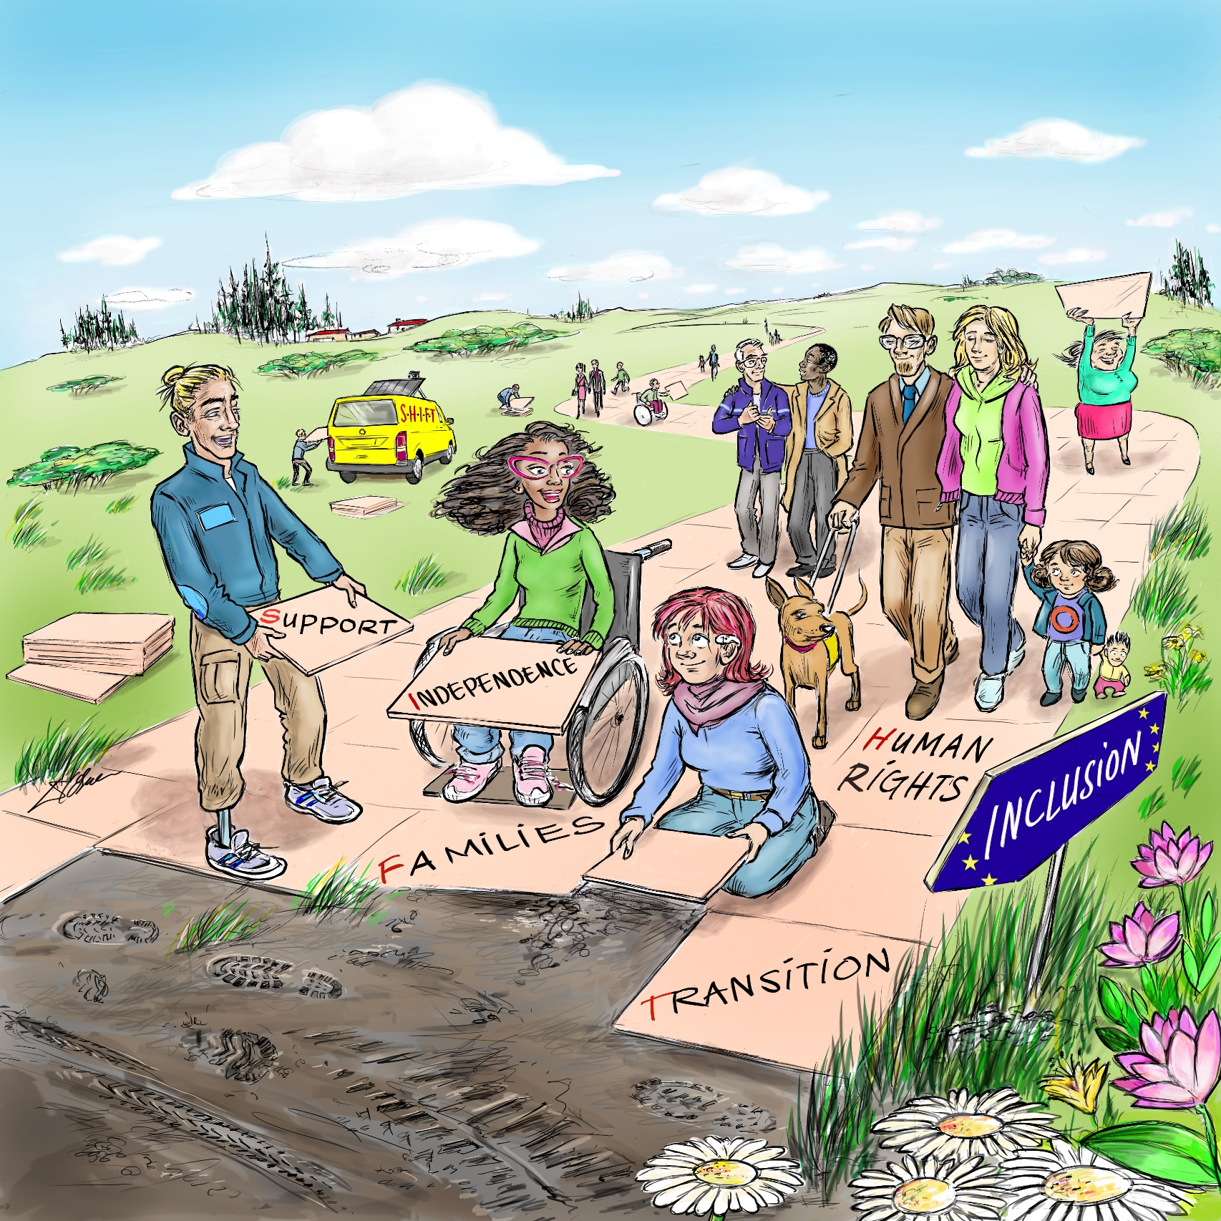
Get in touch with us!
COFACE Families Europe
Tel: +32 2 511 41 79
Email: croux@coface-eu.org
Website: www.coface-eu.org
Join us on: Twitter @COFACE_EU
and Facebook /COFACE.EU
and Instagram familieseurope
#FamilyCentredECI

